Slide 1
Controlled Assessment
Samuel Simpson
Centre Number: 51339
Candidate Number: 6041

Slide 2
Chosen Brief
Design Task 8 – Sound and Music

Slide 3
Chosen Brief
Context
Modern technologies based on music and communication play an important part in people’s lives today and can be used as strong personal statements.
Design Task 8 - Sound and Music
Design and make a product using sound or music. It could be a toy which plays a lullaby for the baby, an MP3 player dock, doorbell chime, an amplifier for ring tones, even a metronome - the product should reflect its application.

Slide 4
Initial Concept

Slide 5
An Audio Spectrum Analyser
A Black case
A RGB display
A IR Remote control
Microphone input
Aux input
Different Display Modes and Patterns

Slide 6
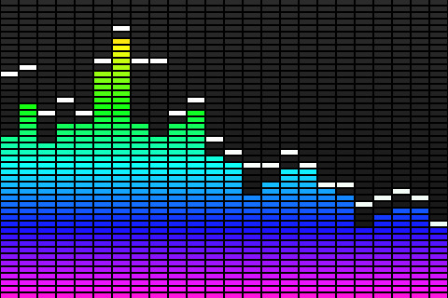
What is audio spectrum analysis?
Spectrum analysis can be used at audio frequencies to analyse the harmonics of an audio signal.
Spectrum analyzers are also used by audio engineers to assess their work.
In these applications, the spectrum analyzer will show volume levels of frequency bands across the typical range of human hearing, rather than displaying a wave.
In live sound applications, engineers can use them to pinpoint feedback.
In short: Spectrum analyzer show the level of the audio at different frequencies and in this case they are more to do with the fact that they look good as a disco-light.
In this instance I plan to make one to be a disco-light as otherwise I would have to get it calibrated and I do not plan to get it calibrated as the input resolution required would need an accurate audio input and it is just better to use a computer's sound-card and some free software such as Spek.

Slide 7
Research
Product Analysis

Slide 8
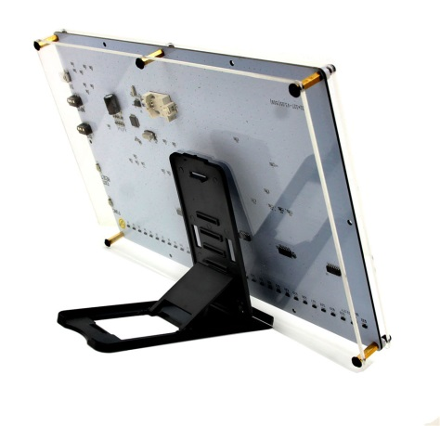
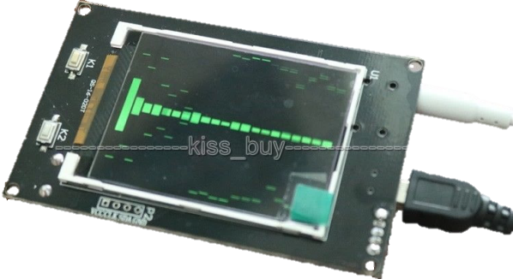
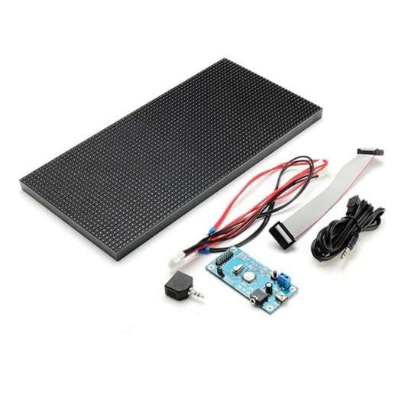
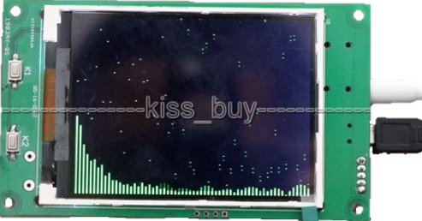
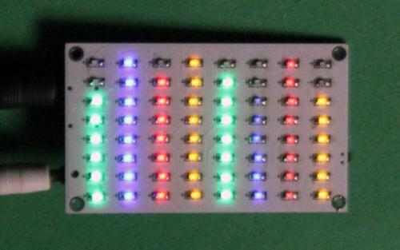
Similar Products
RGB 32*32 Screen
2.4" LCD Music Spectrum Display
MS3264 V3 digital Level Meter
3.2" LCD Music Spectrum Display
8*8 Audio Level Meter

Slide 9
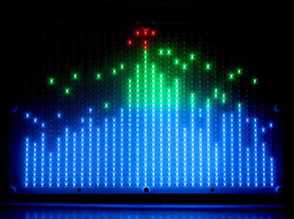
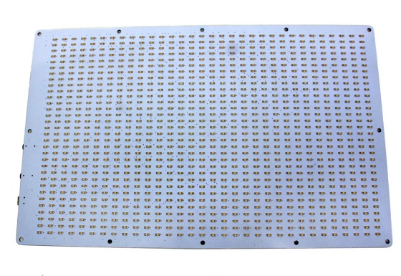
PRODUCT: RGB 32*32 Screen Audio LED Level Meter Display Spectrum Analyser DIY Amplifier
Feature | Description | Comment
Cost | £61.75 + £9 P+P | Expensive for what it is as it has a cheap plastic case which looks like it would break easily
Aesthetics | Clear Plastic, White PCB, Visible Components ½ Kg Coloured Leds Large (25x15cm) | Not very pretty as components are visible Light Leds are fixed colours The casing material makes the product look cheap
Customers | Audiophiles, Techies | Limited Market Due to Aesthetics as all the electronics are visible and the product looks cheap because of the casing material
Materials | Plastic/PCB/Acrylic | It is made of cheap materials as it is not a very high quality product
Environment | Nothing Recyclable | Not Environmentally Friendly as the product is made using plastic which is recyclable in some case but as it is a mixture of plastics and it contains electronics it is not recyclable
Safety | 5v @ 150mA Lightweight | Low power/current so no risk of electrocution Lightweight so it won’t hurt someone if it fell on them It has rounded corners
Function | Lights up the individual columns depending on the level of the audio in that specific frequency range | It can be used for Party's/Discos as the light flash in time with the beat
Parameters:
Power from: USB 5V,150mA
Box size:275mm*170mm
LED size:250mm(W)*150mm(H)
32*32 matrix LED display.
Net weight: 0.5Kg (0.8Kg with package)
Features:
the LED will dance with the music.
with memory function （need install the battery）
5 style display mode
Can display the year / month / date / hour / min / week
Can adjust the LED speed / L&R channel display mode / Gain / Sensitivity / brightness
The display frequency range is: 300/600/900/1.2K/1.5K/1.8K/2.1K/2.4K/2.7K/3K/3.3K/3.6K/3.9K/4.2K/4.5K/4.8K/5.1K/5.4K.......total 32 rows.
Package included:
1x LED display panel
1x stand
1x USB cable
1x 3.5mm cable

Slide 10
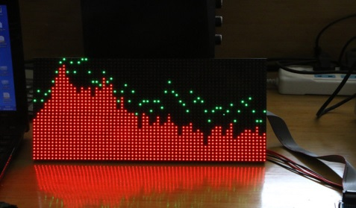
PRODUCT: MS3264 V3 digital Level Meter Music Spectrum Display 6 Modes DIY LED Audio amp
Features:
Using the latest SMD dual colour dot-matrix display modules, more vivid colours and lower power consumption.
Dot-matrix screen software using the original software filtering technology, spectrum effects has increased significantly.
Main features:
Spectrum display more gentle, no spikes appear. Sensitivity and sense of rhythm is better, visual effects more beautiful.
Improved the other spectrum frequency is too rich, insufficient high frequency phenomena, the effect is more dynamic. With power off memory function.
The streamlined design of the spectrum, not static and noise.
Package Contents
1x Controller
1x Colour dot matrix
1x USB power supply audio cable
1x audio splitter
1x 16-core data cable
Feature | Description | Comment
Cost | £45.99 | Expensive for what it is as it does not come with a case enclosing the electronics
Aesthetics | Clear Plastic, PCB, Visible Components ½ Kg Coloured Leds Large | Not very pretty as components are visible Light Leds are fixed colours Components are not one unit
Customers | Audiophiles, Techies | Limited Market Due to Aesthetics as it does not have a proper case
Materials | Plastic/PCB | It is made using the bare minimum of materials to make the product work but as it does not have a case enclosing the electronics
Environment | The metals used to make the cables, components and PCB can be recovered but the plastic is most likely not recyclable | Partially Environmentally Friendly as the component it is a mixture of plastic and electronics which cannot be separated but the metals could be extracted
Safety | 5v Lightweight | Low power/current so no risk of electrocution Lightweight so it won’t hurt someone if it fell on them It has sharp corners
Function | Lights up the columns to show the level of the audio in the frequency range | It can be used for Party's/Discos as it flashes in time with the beat but it can also be used for sound engineers to see what frequencies can currently be heard

Slide 11
PRODUCT: 8*8 Audio Level Meter LED Display Amplifier HIFI MP3 PC Music Spectrum Analyser
Feature | Description | Comment
Cost | £8.01 | Cheap as it is just a bare PCB with no proper case to protect the
Aesthetics | Clear Plastic, White PCB, Visible Components Small Coloured Leds | Not very pretty as components are visible Light Leds are fixed colours Looks Cheap The re is no case to protect the PCB
Customers | Audiophiles, Techies | Limited Market Due to Aesthetics as it is just a plain PCB with some component s
Materials | Plastic/PCB | Cheap as it does not include a case to protect the PCB
Environment | PCB and components recyclable as the metal can be extracted | The metals used to manufacture the product can be extracted from the components and PCB so it can be recycled
Safety | 5v Lightweight | Low power/current so no risk of electrocution Lightweight so it won’t hurt someone if it fell on them It has sharp corners
Function | Lights up the bars to show the level of the frequency in that range | It can be used as a toy but is not very practical for anything as the resolution is so low

Slide 12
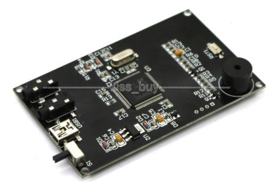
PRODUCT: 2.4" LCD Music Spectrum Display Analyser MP3 PC Amplifier Audio Level Indicator
Feature | Description | Comment
Cost | £14.99 | Cheap as it does not have a case to protect the PCB against damage
Aesthetics | Clear Plastic, PCB, Visible Components ½ Kg LCD Screen Small | Not very pretty as components are visible Light Screen Is small The is not case so the PCB is not protected
Customers | Audiophiles, Techies | Limited Market Due to Aesthetics as it does not include a case
Materials | Plastic/PCB | Cheap as there is to case to prevent the PCB from getting damaged
Environment | PCB and components recyclable as the metal can be recovered | The metals used to manufacture the product can be extracted from the components and PCB so it can be recycled
Safety | 5v Lightweight | Low power/current so no risk of electrocution Light so cannot crush people It has sharp corners
Function | Lights up the individual columns with the level of the frequency of the sound in that specific frequency range | It can be used as a toy or it can be used by sound engineers to check audio levels but cannot be used at Parties/Discos as it is too small
Features:
Spectrum display interface.
Default parameters:
Mode 0,
display mode :(10 modes)
Columnar spectral width: 2
Gain: 0.5
Adjustable Gain (0.125,0.25,0.5,1,2,4.)
Foreground colour: GREEN
Adjustable colour "WHITE", "BLACK", "BLUE", "BRED", "GRED", "GBLUE", "RED", "MAGENTA", "GREEN", "CYAN", "YELLOW", "BROWN", " BRRED "," GRAY.
Background Colour: BLACK
Adjustable colour "WHITE", "BLACK", "BLUE", "BRED", "GRED", "GBLUE", "RED", "MAGENTA", "GREEN", "CYAN", "YELLOW", "BROWN", " BRRED "," GRAY.
Package Contents
1x 2.4" TFT LCD level display music spectrum electronic rhythm Analyser
2X CABLE

Slide 13
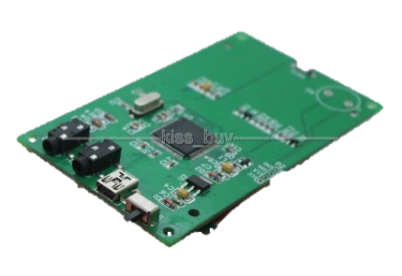
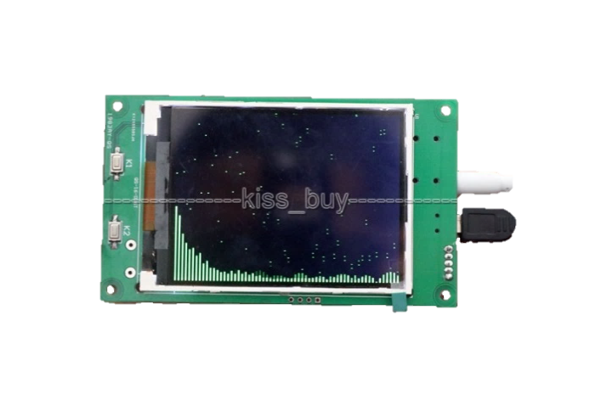
PRODUCT: 3.2" LCD Music Spectrum Display Analyser MP3 PC Amplifier Audio Level Indicator
Feature | Description | Comment
Cost | £18.89 | Cheap as it does not have a case to prevent the PCB from getting damaged
Aesthetics | Clear Plastic, PCB, Visible Components ½ Kg LCD Screen Small Lots of frequency bars | Not very pretty as components are visible Light Screen Is small Looks better with more bars It does not have a case
Customers | Audiophiles, Techies | Limited Market Due to Aesthetics as the is not case surrounding the PCB
Materials | Plastic/PCB | Cheap as it does not have a case to protect the PCB
Environment | PCB and components recyclable | The metals used to manufacture the product can be extracted from the components and PCB so it can be recycled
Safety | 5v Lightweight | Low power/current so no risk of electrocution Light so it won’t hurt anyone if it fell on them It has sharp corners
Function | Lights up the individual columns with the level of the frequency of the sound in that specific frequency range | It can be used as a toy or it can be used by sound engineers to check audio levels but cannot be used at Parties/Discos as it is too small
Features:
Spectrum display interface.
Default parameters: Mode 0,
display mode :(10 modes)
Columnar spectral width: 2
Gain: 0.5
Adjustable Gain (0.125,0.25,0.5,1,2,4.)
Foreground colour: GREEN Adjustable colour "WHITE", "BLACK", "BLUE", "BRED", "GRED", "GBLUE", "RED", "MAGENTA", "GREEN", "CYAN", "YELLOW", "BROWN", " BRRED "," GRAY.
Background Colour: BLACK Adjustable colour "WHITE", "BLACK", "BLUE", "BRED", "GRED", "GBLUE", "RED", "MAGENTA", "GREEN", "CYAN", "YELLOW", "BROWN", " BRRED "," GRAY.
Package Contents
1x 3.2" TFT LCD level display music spectrum electronic rhythm Analyser
2X CABLE

Slide 14
What key Features Have I found from these products
Using lots of frequency bands looks good
Using pure (Red, Green, Blue) colours is bad as it is quite harsh to look at
They need a attractive case to be appealing to people who are not techies who like circuit boards with components on
Colour customisation – Led's can change colour
Using individual Led's looks good
Easy to use controls are a must
The option to use a microphone or a audio input port is a good idea
Using proper packaging is a good idea
A user manual would be very important
Different display modes would look good
Using a low voltage with a low current so there is a low risk of electrocution
Black is a good case colour as it is high contrast and doesn’t reflect the colour of the surrounding Led's
Producing a single unit is a good idea

Slide 15
Research
Survey
- Multiple Choice

Slide 16
What is your age?
Most the people who answered my survey were aged between 10 and 17.
This means that my results show the views of people aged between 10 and 17.
This does not mean that people of different ages have the same views as they did not answer the survey.
But I did get some results from the other age groups and so I can draw a few conclusions for the other age groups

Slide 17
What is your gender?
I got nearly an even split with the genders of the people who answered the survey
This is good because I have responses from both genders and it means I know what both genders want

Slide 18
Which of the following would describe your familiarity with audio spectrum analysers?
Most of the people who answered the survey did not know what an audio spectrum analyser was.
This could be because they did not know what they were specifically called as they might not be very technical as they might just think that they are just a cool light effect
Some people had actually heard of it so I can draw some conclusions from these results

Slide 19
If you already own, or regularly use this product, then please state how long for.
I got little results for this as most people as they do not know what an audio spectrum analyser is.
So I cannot draw any conclusions from these results

Slide 20
How often would you use this type of product?
Most people did not know what an audio spectrum analyser is and so most of them did not know when they would use it, but some people said that they would use it at least once a week

Slide 21
Similar Products
RGB 32*32 Screen
2.4" LCD Music Spectrum Display
MS3264 V3 digital Level Meter
3.2" LCD Music Spectrum Display
8*8 Audio Level Meter

Slide 22
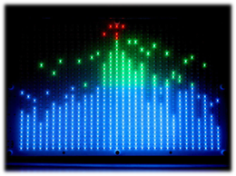


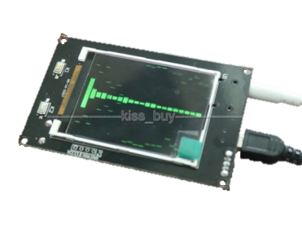
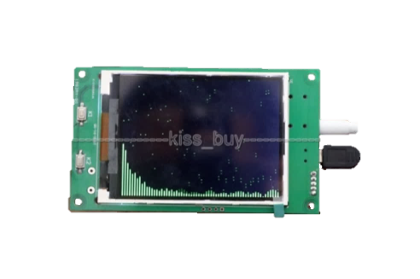
Which one would you most likely buy?
1 | 2 | 3 | 4 | 5
RGB 32*32 Screen | MS3264 V3 digital Level Meter | 8*8 Audio Level Meter | 2.4" LCD Music Spectrum Display | 3.2" LCD Music Spectrum Display
£61.75 | £45.99 | £8.01 | £14.99 | £18.89

Slide 23
Which one would you most likely buy?
Most people liked the first picture due to the amount of detail and the colours.
They liked it because they said it looks high quality as it is expensive which means that they assume that it is high quality

Slide 24
Research
Survey
- Open ended questions

Slide 25
What do you like most about this product?
Many people liked the multiple colours
They also liked he size and the resolution of the larger products
They also thought that the products look attractive

Slide 26
What don't you like about this product?
They though the products were expensive but most did not know what an audio spectrum analyser is and the average price you would pay for one
So most people do not have much experience in the pricing of audio spectrum analysers

Slide 27
If I was to make one what would you want it to have?
Many people want me to make my unit multi coloured
They also want me to make it easy to use and have multiple inputs
They also want it to look nice and be large
They would like the casing to be made out of wood

Slide 28
What would you expect to have to pay for this product?
Average: £34.09
The people who answered my survey did not know mych about audio spectrum analysers
So their target price was lower than it would be and also my product will cost more as it is a prototype

Slide 29
Research
Survey
- Conclusion

Slide 30
Survey Conclusion
Most People Don’t Own A Spectrum Analyser
Most People are not sure how often they would use this product
The No. 1 Spectrum analyser was the RGB 32*32 Screen priced at £61.75 – This was based on aesthetics only – The people surveyed were only given a picture and a price
The thing they likes the most was the multiple colours, followed by how attractive it was
The thing they disliked the most was that they were expensive and they disliked that they didn’t have remote controls
They wanted multiple colours the most, followed by it having multiple audio inputs, then a wooden casing
The average price they would pay for it was £34.09

Slide 31
What I will do based on the Results
Make It Relatively large
Make it Multi Coloured with colour customisation
Make it Look Good
Have a high resolution for more detail
Make it easy to use
Make it low-cost
Add a remote control
Make it user friendly
Make it’s case out of wood

Slide 32
Research
Brainstorm

Slide 33
Inputs
Product | Buttons | IR Remote | DMX | Glediator | Switch
Use in product | To perform the same basic functionality as the IR Remote but more basically | To be the main input for the unit to control and setup the unit. To switch between display modes and patterns and setup information such as DMX address | A standard protocol using XLR connectors which transfers data using RS485 which is common in the lighting industry. It will be used to perform the functionality of the IR remote, remotely | A protocol use for controlling large LED matrices with a computer over serial. This will be used for the LED panels to be used as a screen to display stuff | To switch between DMX, Glediator and IR Remote modes
Advantages | Simple Easy to understand Low-cost | Simple Wireless Cheap Allows unit to be hard to get to but easy to control | Industry standard Compatible with large lighting systems | Helpful Allow control of the unit for each pixel individually Easy to implement Cheap | Easy to understand Hard switch keeps state between reboots No remote needed
Disadvantages | Requires space Large Very basic | Needs batteries Easy to lose | Large connectors | Easy to damage | Hard to access as it would be on the back of the unit
Will I use it | No because there will need to be a lot of buttons to manage the device | Yes it will be the main input device for the unit as it will be used for all configuration of the unit and selecting modes | Yes it will be used to preform the basic functionality of the remote for use with lighting systems | Yes as it allows the LED panels to be controlled by an external computer so the user will able to display whatever they want | Yes as you usually would just set the mode and leave the device in that mode

Slide 34
Audio Inputs
Product | Auxiliary port | Microphone | Internal MP3 Player
Use in product | To input audio from a standard 3.5mm stereo audio connector | To allow the unit to be used by picking up ambient sound and not requiring audio cables | To allow music to be played from removable media e.g. SD card/USB drive
Advantages | Simple Commonly Used Standard Most people have one Cheap | Simple Cheap Allows the unit to be used without any external cables – just a power cord | Allows unit to play music without any external devices
Disadvantages | Requires an audio cable to be plugged into the unit | Picks up ambient noise Low quality Muffled as it will be inside the unit | The would have to be no screen and wherever it is mounted it would look out of place Hard to use No one really used them any more they just use their phones An external amplifier would be needed
Will I use it | Yes because it would offer higher quality than the Microphone, it would also have a pass-through socket to allow it to pass the audio in to an amplifier | Yes because it will make the unit be able to function without needing any audio cables so it can be place far away from the amplifier and if it still had sound it would be able to function | No because you would need an external amplifier anyway so it would be pointless as you could connect any device to the AUX port instead and no one uses them anymore

Slide 35
Processing
Product | PIC Microcontroller | ATMEGA Microcontroller | MSGEQ7 IC
Use in product | To be an alternate main controller of the unit | To be the main controller of the unit and deal with controlling the LED panels and convert the audio to the separate bands via FFT | To convert the audio into frequency bands
Advantages | Simple Easy to understand Low-cost | It has a large amount to SRAM which is required to control the LEDS and perform the FFT Large amount of libraries available Programmed using C (I have experience in using the language) | Simple No programming needed
Disadvantages | Requires programming Programmed using basic which is very low level Not that many libraries available Low amount of SRAM Not as fast as the ATMEGA | Expensive Requires programming | Only 7 frequency bands Cannot directly control the addressable LED panels
Will I use it | No as I will have to write all of the code from scratch for controlling the LEDs and I do not have experience of programming in PIC BASIC and programming it using a flowchart is too basic for performing complicated functions like I am and also they do not have a large a | Yes as the device can perform the FFT needed to convert the audio into digital frequency bands and then directly control the LED panels and it will also be able to load patterns of an SD card and load them onto the panel. Also it will require less programming as people have made libraries for uses such as FFT and controlling addressable LEDS | No as it would require an external controller to convert the Frequency bands into digital signals and it only have 7 bands which is quite small and it is very basic

Slide 36
Outputs
Product | Status LED | Addressable LED Panels | Buzzer | Speaker | 7 Segment Displays
Use in product | To show basic information such as power and a another LED to show if it is getting and IR signal | To be the main output of the unit to display the audio spectrum like a bar graph with different display modes. It has RGB Leds that are individually controllable | To make a sound to indicate statuses such as a missing SD card or receiving a signal from a IR remote | To play the audio that the unit is receiving so no external speakers are needed | To show the mode the unit is in or other information
Advantages | Simple Easy to understand Low-cost Easy to read quickly no confusing codes | Big Bold Large amount of customisation Requires only 1 output on microcontroller | Simple Can be inside the unit – no external cut-outs needed Easy to notice – you do not need to look at the unit | Helpful External speakers are not needed with the unit | Easy to read Can be used with external
Disadvantages | Can draw unwanted attention Can | Expensive Large Power consumption (up to 15A @ 5v per panel) | Annoying Can be unwanted Hard to make it give meaningful information | Needs amplification Hard to produce proper stereo sound Will most likely have very little bass | Large They look ugly as they are very basic
Will I use it | Yes it will be in the power switch to show the unit has power | Yes the will be the main output device for the unit as the can display various patterns and colours | Yes it will be inside the unit on the PCB and will be used to indicate when it receives an IR signal | No as the people who would use this unit would most likely have a speaker system better than some small, terrible speakers | No as they would use up valuable space on the front of the unit whereas the LED panels could also be used to display the mode

Slide 37
Storage for patterns
Medium | USB memory | SD Card | Internal Microcontroller Storage
Use in product | To store patterns for device | To store patterns in device | To store basic patterns and modes
Advantages | Widely Available and supported Small connector Easy for use to adjust patterns | Widely Available and supported and easy to interface with microcontroller Small connector Easy for use to adjust patterns | Super easy to implement No external device interfacing needed
Disadvantages | Hard to interface with microcontroller Hard to find compatible devices | Some issues with compatibility to | Uses valuable program space Not user customisable
Will I use it | No because it is hard to interface USB memory with a microcontroller | Yes because it is easy to interface and is easily user adjustable | Yes to store a basic pattern and different modes for when the SD card is not available

Slide 38
Research
General

Slide 39
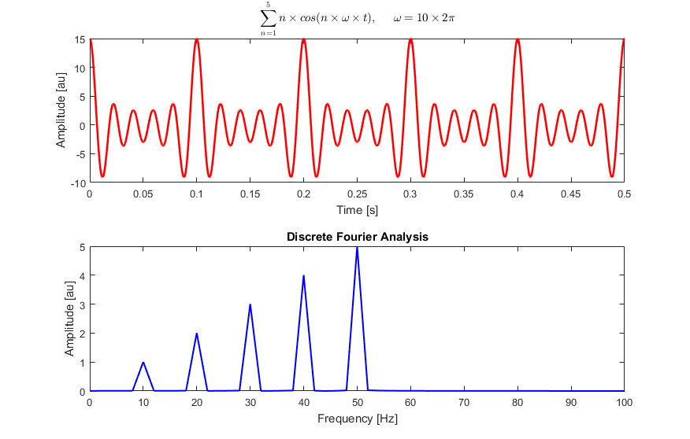
Measuring the audio spectrum
After putting a bit of research into the technology of spectrum analysis, I found out that most use a technology called FFT (Fast Fourier Transform). This uses data that has been sampled regularly over a period of time and then calculates the audio frequencies that it is formed from, including their harmonics.

Slide 40
Measuring the audio spectrum
Other devices use a technology called Fast Hartley Transform (FHT), I plan to use this as it uses less memory and is faster than FFT, which will be very beneficial for use on a microcontroller, which will allow it to be more responsive to the audio signal. This will allow it to react faster to the audio signal, showing the beats of the audio better.

Slide 41
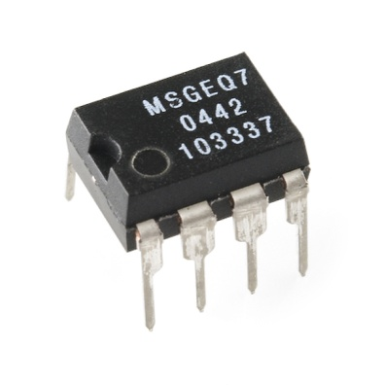
Measuring the audio spectrum
Others might use a chip such as the MSGEQ7 which separates the audio signal into 7 different frequency bands with very little other components needed, but this multiplexes the outputs and requires complicated timing circuitry to get it to function correctly. Due to the limitation of only 7 frequency bands, I decided not to use it.

Slide 42
Research
Possible Circuits

Slide 43
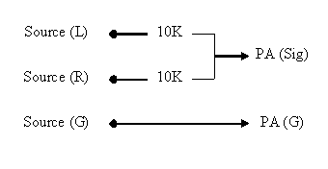
Audio Mixer for mixing the Left and right audio channels
Connect the two audio signals together using a 10k resistor on each of the signals
This circuit construction provides 10 kohm input impedance and around 5 kohm output impedance.
Both of the values are well within what you would expect from an audio equipment.

Slide 44
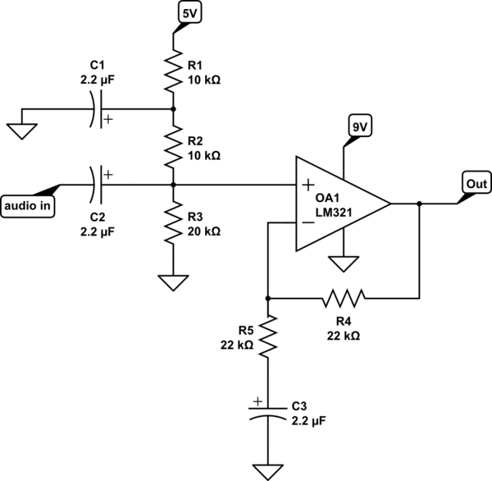
Audio amplifier and leveller
This circuit can be used with the LM324 which is a quad version of the LM321
This can be used for the AUX input of the device

Slide 45
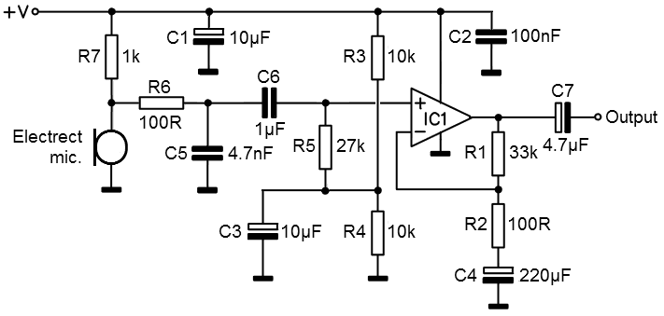
Audio amplifier and leveller
This circuit can be used with the LM324 which is a quad version of the LM321
This circuit can be used for the microphone input of the unit

Slide 46
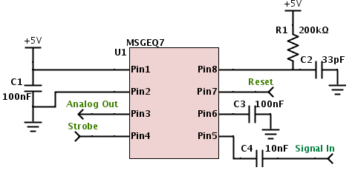
MSGEQ7 - 7 Band filter IC
I did not use this due to the limitations of the MSGEQ7 IC with the specific use case I needed as I opted for a software solution instead.

Slide 47
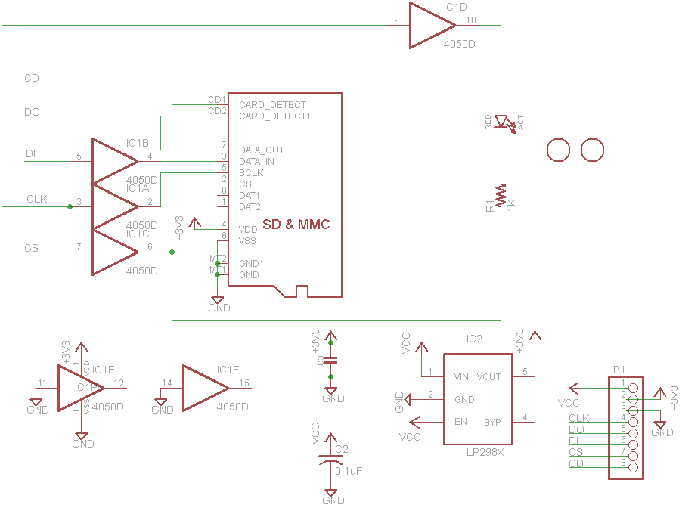
SD Card interface
I used this schematic to allow the microcontroller to communicate with the SD card with only a few component changes where alternative through-hole components were used instead of surface-mount ones.

Slide 48
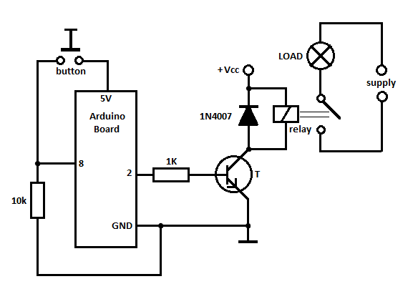
Audio Input Switching Circuit
I decided not to use this and instead to use different analogue inputs instead as it was cheaper to just use a software solution instead of a hardware solution.

Slide 49
Research
Possible Components

Slide 50
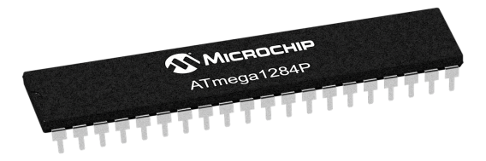
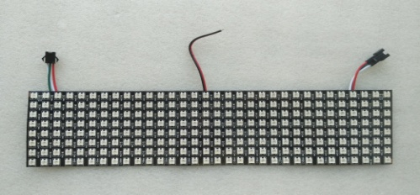
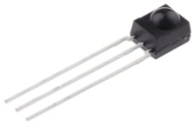
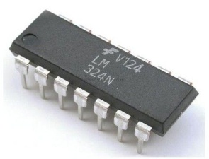
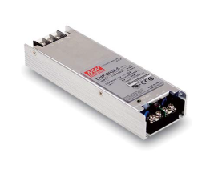
Possible Components
Picture | Component | Use
 | ATMEGA 1284p | To be the main microcontroller of the product and control the LED panels, perform the frequency analyses and interface with the SD card
 | 32x8 WS2812B Led Panel | To be the display of the product to show the different frequency bars and allow customisation of the RGB colour
 | IR Receiver | To receive the signal from the IR remote which will be how the user controls the device
 | LM324 | To convert the audio inputs for the unit into a logic level that the microcontroller can use also it only needs an single power supply so it is easy to use
 | Mean well UHP-200A-5 | To power the unit as the LED panels require 15A maximum each so it can supply 40A at 5v as it is a 200W power supply which leaves 10A spare for other circuitry and the USB port

Slide 51
Research
Possible Software

Slide 52
FHT
I found a library with example code for FHT which ran on the Arduino Bootloader
http://wiki.openmusiclabs.com/wiki/ArduinoFHT
It included example code for basic FHT which I incorporated into my master code with a few alterations to capture the full 20Hz to 20KHz of the human hearing along with the logarithmic frequency banding to more closely mimic human perception of sound.

Slide 53
FastLed
I found a library called FastLed which was a library that ran on the Arduino Bootloader which allowed the microcontroller to easily control LED panels like the WS2812B panels I have
http://fastled.io/
I used some example code to help me write the code to control the LED panels along with some algorithms and functions I created to easily draw onto the display with the required bars using an internal pattern.

Slide 54
Reading Image files from an SD card
After a lot of research I determined it was too hard to read standard image files from and SD card. I created a program in python to allow images to be stored in a database on the SD card in an easy way for it to be easy to decode the images on the microcontroller
It stores the images uncompressed to reduce the amount of processing for the microcontroller
It accepts 32x16 images

Slide 55
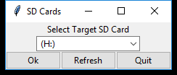
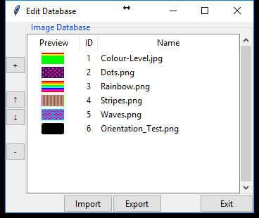
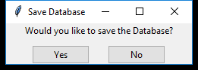
Reading Image files from an SD card

Slide 56
Reading IMAGE files from an SD card
To read files from an SD card the SDFat library allows standard fat – formatted SD cards to be accessed on the Arduino Bootloader
I used some example code to be able to decode the images from the SD card

Slide 57
Product Overview
Product Specification

Slide 58
Specifications
It will have an internal power supply as it will need to produce 30A for the LED panels at 5v.
It will use a standard IEC power connector with a hard power switch.
It will have a black painted wood case to make the display stand out
The wood will be painted black once the unit is assembled to hide the joints in the wood
There will be a clear acrylic sheet in the front of the case to protect the led boards and to stop people touching the led boards
Picture hook for the option to wall mount the unit
It will have mounting slots on the back for laser cut acrylic legs to make the unit more stable so it doesn’t fall over. The acrylic legs will have holes in them for a screw in the side of the case to slot into them so they are secure and they don’t fall out
It will have the power socket, audio ports and SD card slot recessed on back of unit in a recess that so when it is on a wall it lies flat. The recess will have the inputs at a 90° angle so the ports are facing sideways. The recess will be fairly large to allow for different connector sizes and cables
It will have a groove cut out of bottom lip on unit so cables can run down the wall it is mounted on
It will have a hard power switch on side of unit so power can be completely isolated from the unit to minimise fire risk
The audio inputs it will have
Microphone for use with audio sources which can be heard by the unit and do not want to use an Aux cable
Microphone should be mounted to the front of the unit for the best signal from the sound in the surrounding area
Microphone needs a preamp to bring it up to line level
3.5mm audio socket with another 3.5mm audio socket for pass-through and isolation so it doesn’t distort the audio going in if they are using a passive splitter
Audio must be actively converted to mono to prevent distortion on the audio input as it could be passively split somewhere or be using the pass-through socket
All audio inputs must be isolated from each other and when a input is selected it must pass through an auto volume control circuit before entering the microcontroller. So the audio can be scaled to get the most amount of detail out of it
It will have an IR remote control for control without touching the unit
A button on the remote should be used to change between the audio inputs and turn of the unit in turn in the pattern: Aux socket, Microphone, Off
A button on the remote should be used to change the display style for the spectrum analyser, modes could include variants of live mode showing the current audio frequencies, peak hold mode where dots show when the audio peak in the last few seconds and how high the peak was, and a mode when the whole screen is on and gets dimmer and gets brighter when a beat happens in the audio. The modes could include horizontal or vertical variants of these modes.
A button on the remote should be used to change the colour pattern of the screen. Patterns would be stored on a SD card with a picture for each pattern so the user could create their own patterns
The unit must have an SD card slot for image files stored on an SD card. The file format used will be a custom file type for storing images for the led matrix
Images will be stored in a folder called .imx

Slide 59
Social and Moral Issues
The product will have bright lights which could disturb other people
The product would usually be used with some speakers so they could disturb other people
The product will be designed so that it can be repaired if it breaks
The product could be dangerous to people with photosensitive epilepsy due to the flashing lights on the display

Slide 60
Environmental Issues
Most of the case will be made out of soft wood and plywood
The wood can be sourced from sustainable sources which are FSC approved
FSC means that the wood is sourced from sustainable locations where the trees are replanted and managed to prevent deforestation
Some parts of the case will be made of plastic which can cause issues due to recycling as they could not be widely recycled
The circuit does not contain any batteries which is good because they could damage the environment by being incorrectly disposed
The screws will be metal which is widely recyclable
The solder used will not be lead-based so it will not poison the environment when it is disposed
The copper on the PCB will be able to be reclaimed as it is worth quite a lot which helps the environment as it is a lot easier and requires a lot less energy than making new copper from copper ore which releases a lot more pollution

Slide 61
Product Overview
Physical Design
- 3D Designs

Slide 62
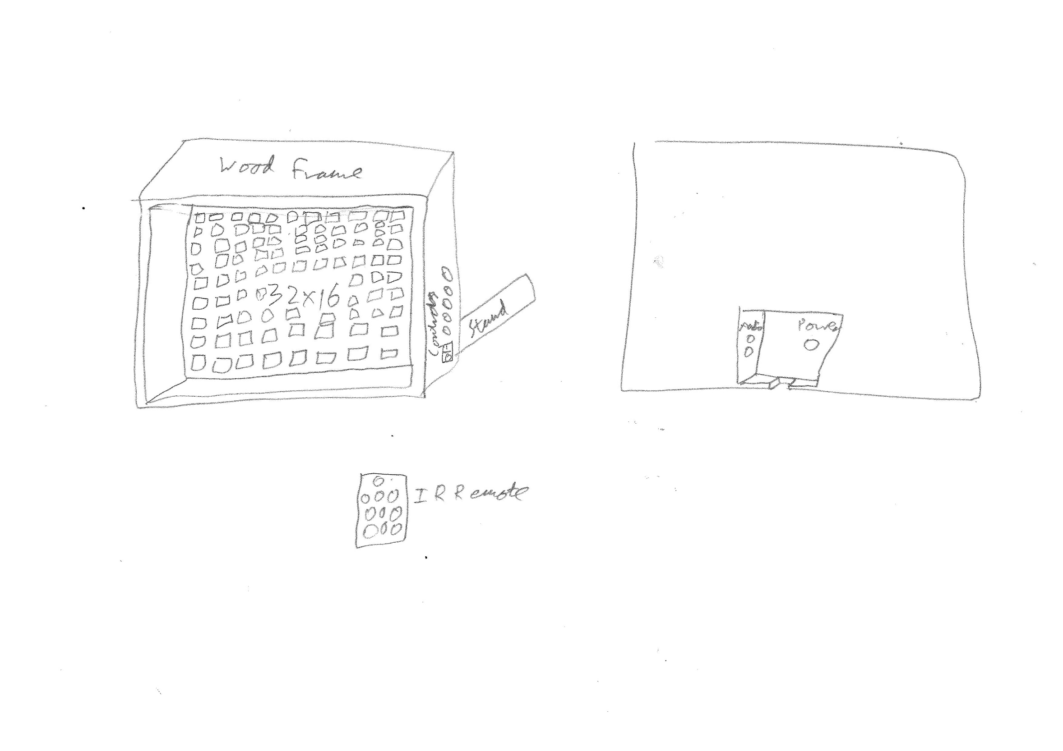
Original Design

Slide 63
Original Design
I gave it a simple box shaped design to allow the LED panels to become the spotlight of the product
I put all of the connectors inside an indent in the back of the case to allow the case to sit flat against a surface, allowing it to be hung on a wall like a picture frame

Slide 64
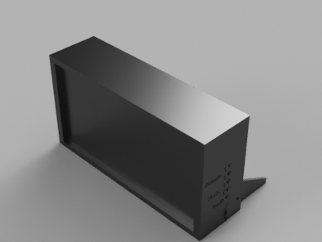
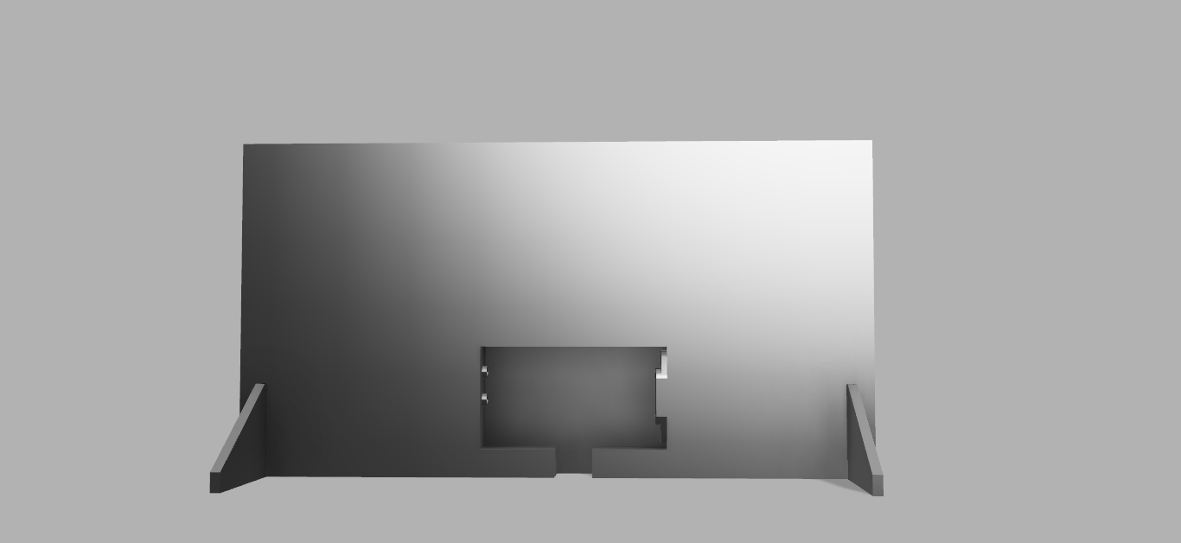
V1
LED Panels
Side Controls
Audio Ports
Rear Stands
AC Port

Slide 65
V1
I converted the design into a 3D model in Autodesk Fusion 360
I used some simple shapes to represent the buttons and connectors just to get a feel for how they will look

Slide 66
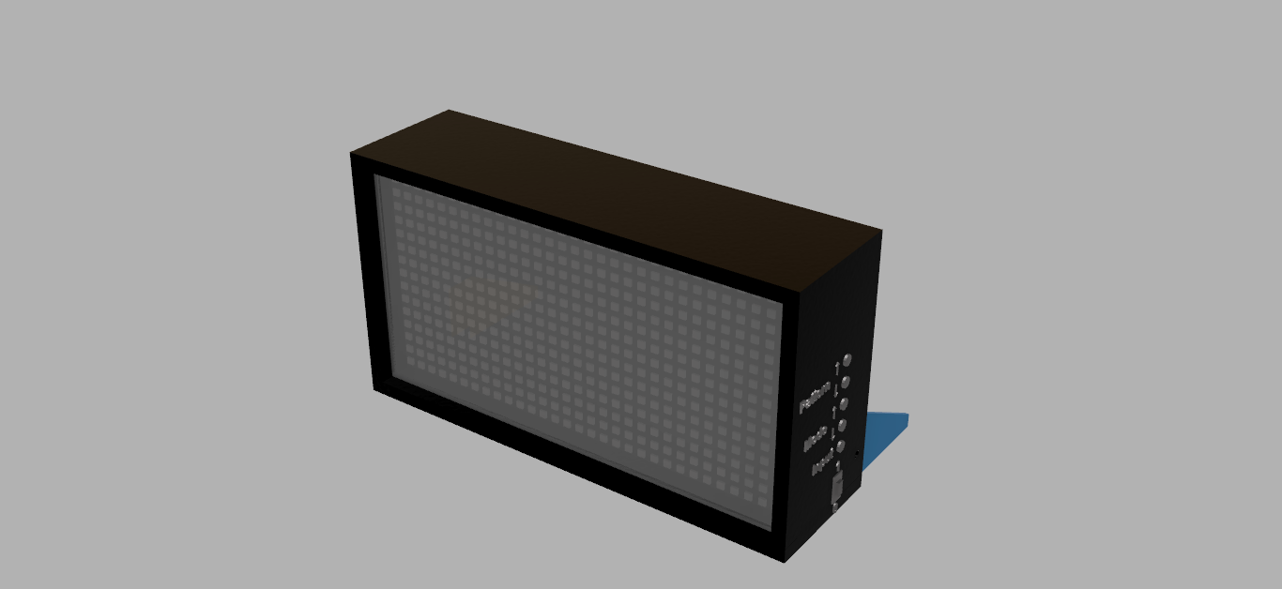
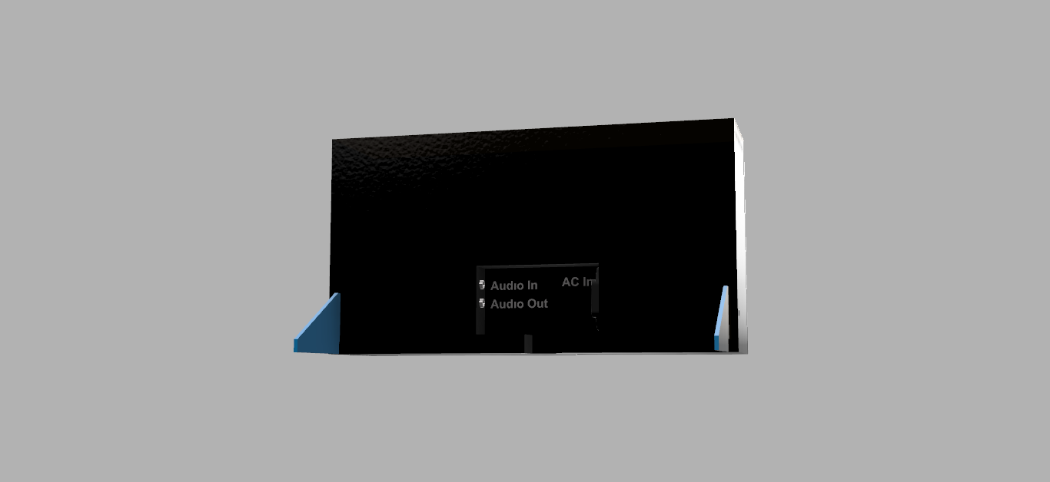
V4
Screen Cover
LED Panels Behind

Slide 67
V4
I began converting the design into separate components
I separated the stands, led panels and the piece of acrylic to protect the fragile led panels from being touched and from dust entering the case.

Slide 68
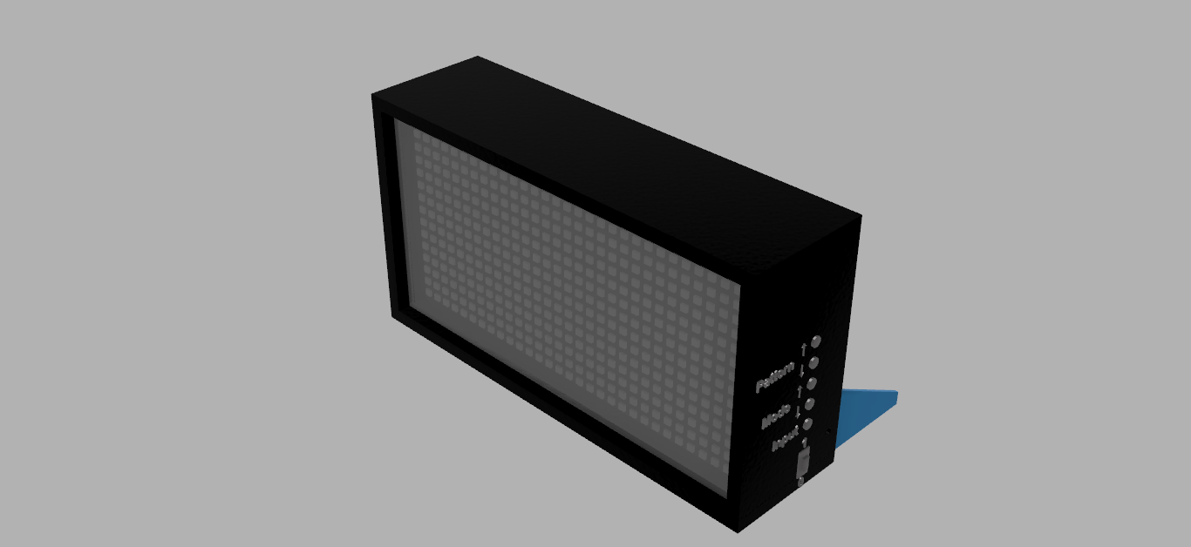
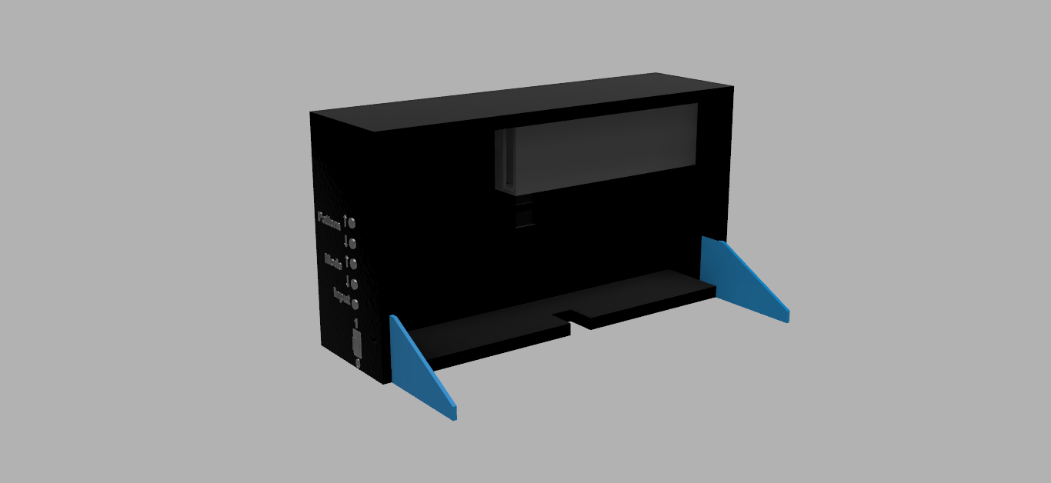
V7
Power Supply
Power Supply Holder

Slide 69
V7
I separated the case into a system where individual case components would slot into grooves in the sides of the case which would be thicker and held together with screws
I designed a holder to securely hold the large power supply that is needed to be able to power the LEDs

Slide 70
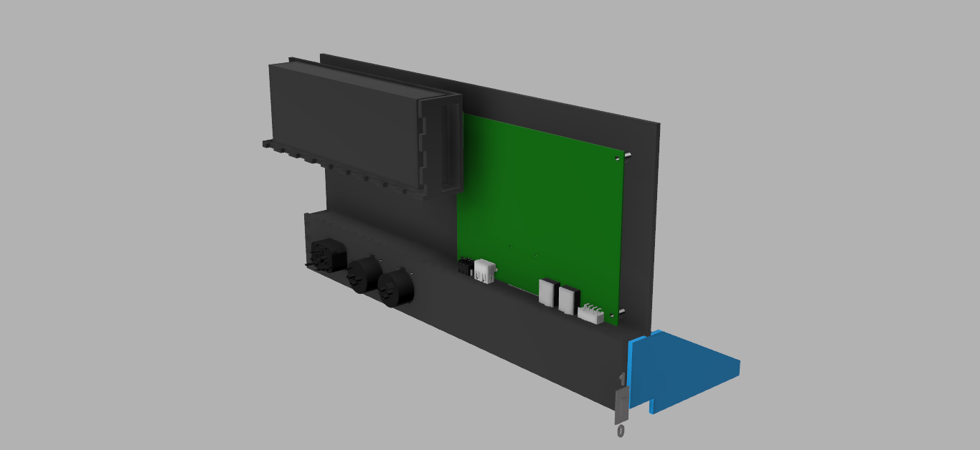
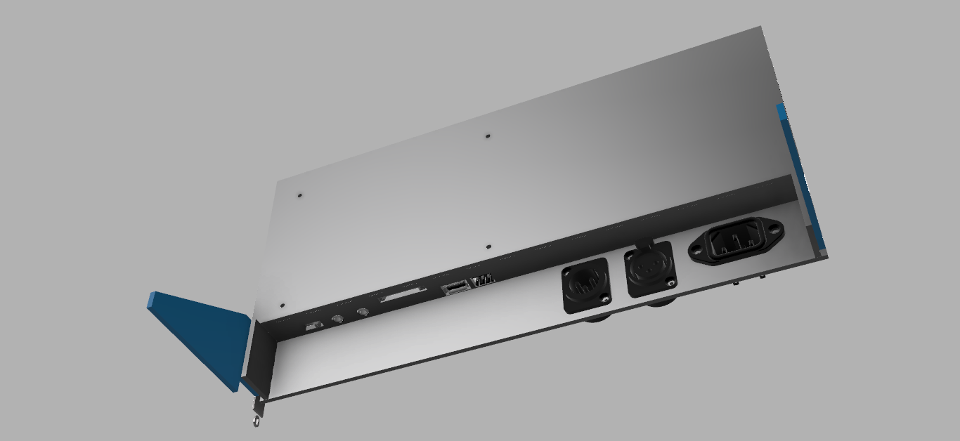
V20
Main PCB
AC Port
DMX Ports
Glediator Connector
USB Charging Port
SD Card Slot
Audio Ports
Pattern Mode Switch

Slide 71
V20
I changed the case to have a larger hole in the back to hide away cables and allow more ports
I created the back of the case using 3D models of the connectors I would use to accurately create the mounting holes to secure them
I created a basic PCB design which I used to place the connectors I would use on it to allow holes to be cut into the case to allow access to the connectors
I created 3D PCB spacers to accurately hold the PCB away from the back of the case to allow it to be mounted securely and allow the ports to line up correctly with the holes cut into the case

Slide 72
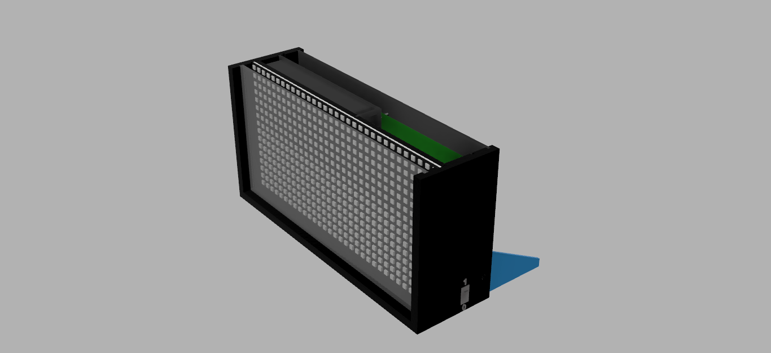
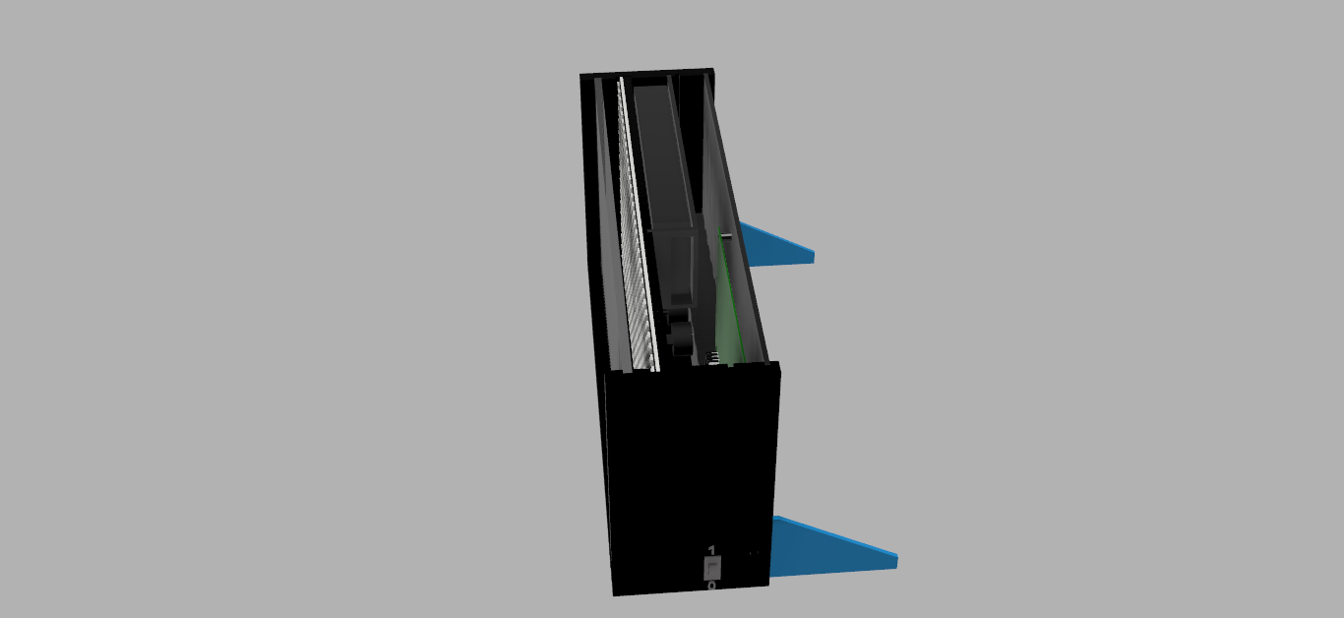
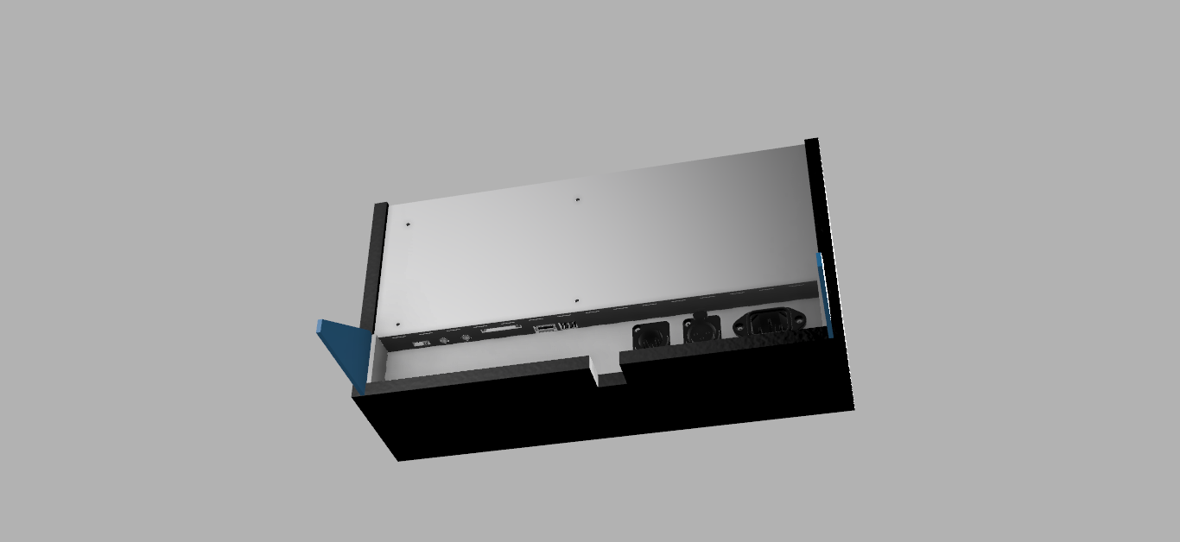
V21

Slide 73
V21
I created panels to allow the LED modules to be attached to them with strong double sided tape because they do not have any mounting mechanisms to securely mount them
I created channels in them to allow the cables to be managed and easily route them to the power supply and PCB

Slide 74
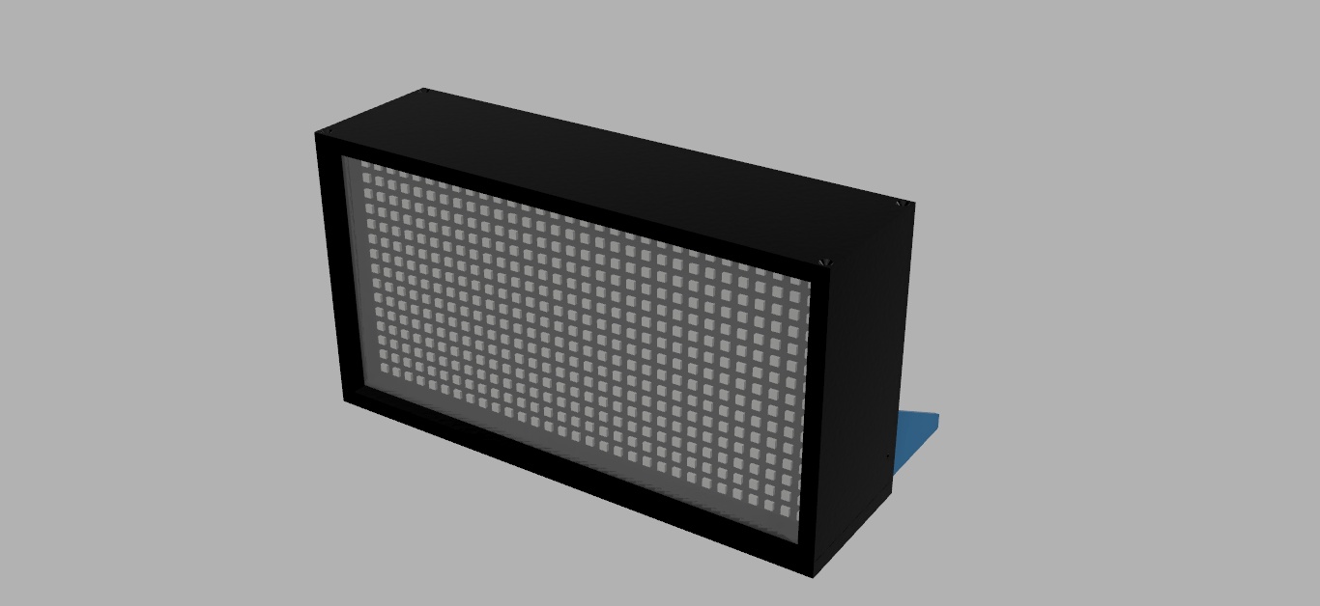
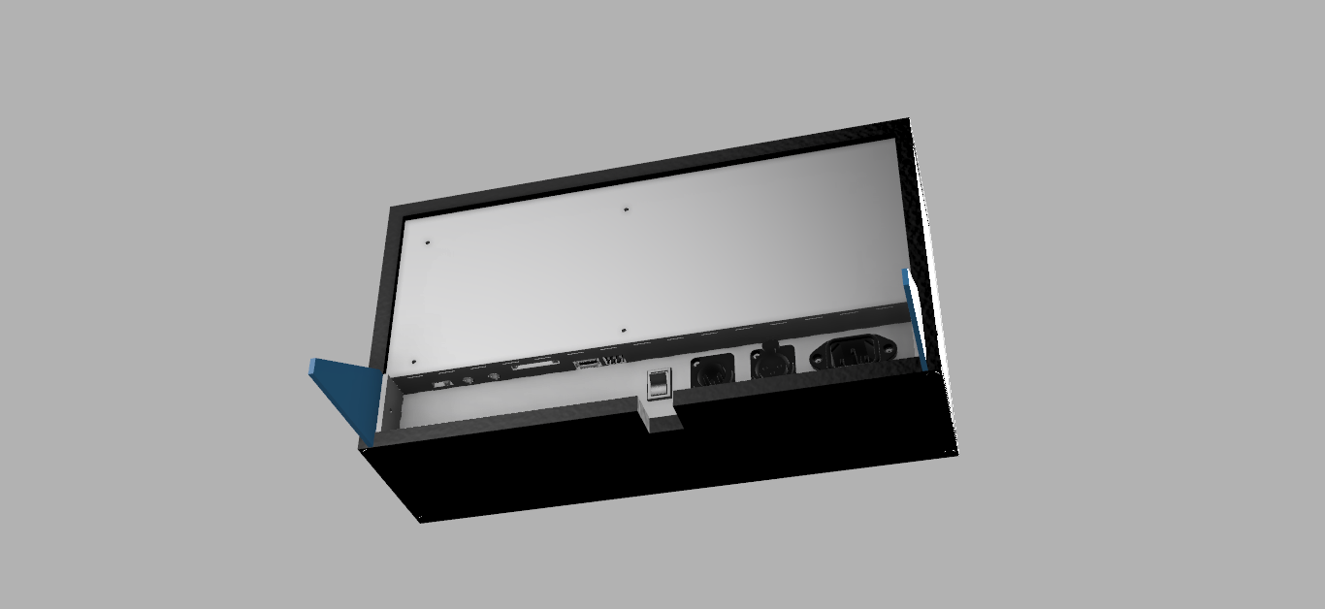
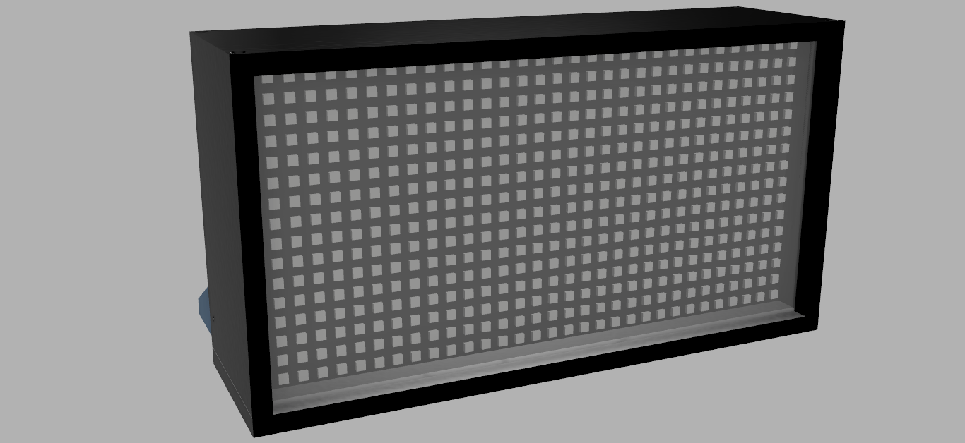
V37
Screw Holes
Power Switch
IR Receiver

Slide 75
V37
I added a space in the front of the case to allow and IR receiver to be mounted to it, allowing the device to receive the IR signals from the remote to control it
I created chamfers to the screw holes to allow the screws to fit flush with the edge of the case
I moved the power switch from the side to the back as it is a hard power switch which isolates the power supply from the main power and the device will be able to be put in standby mode using the IR remote as it is the main controller for the device

Slide 76
V44

Slide 77
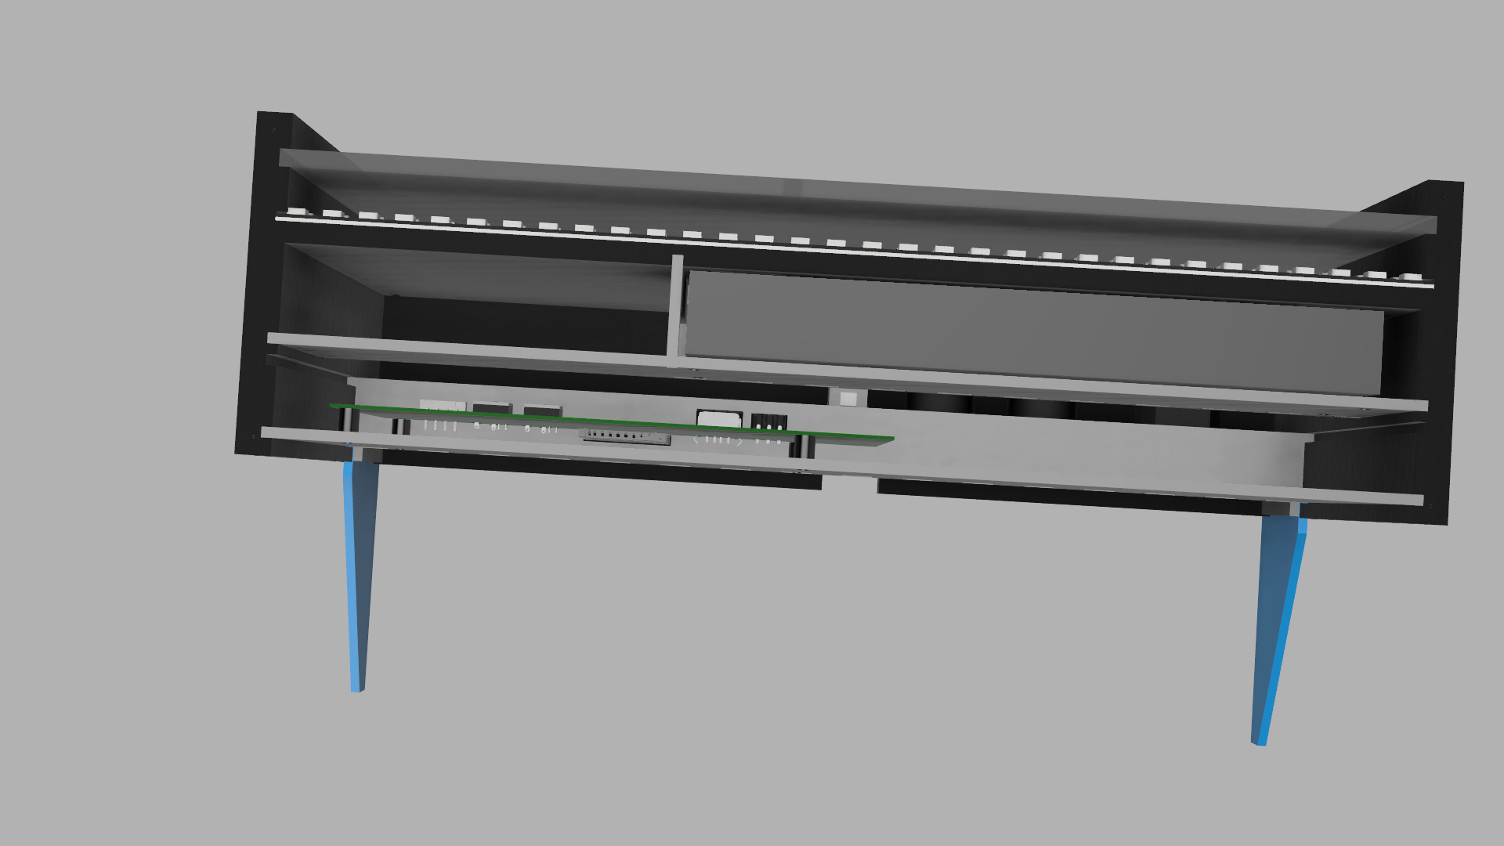
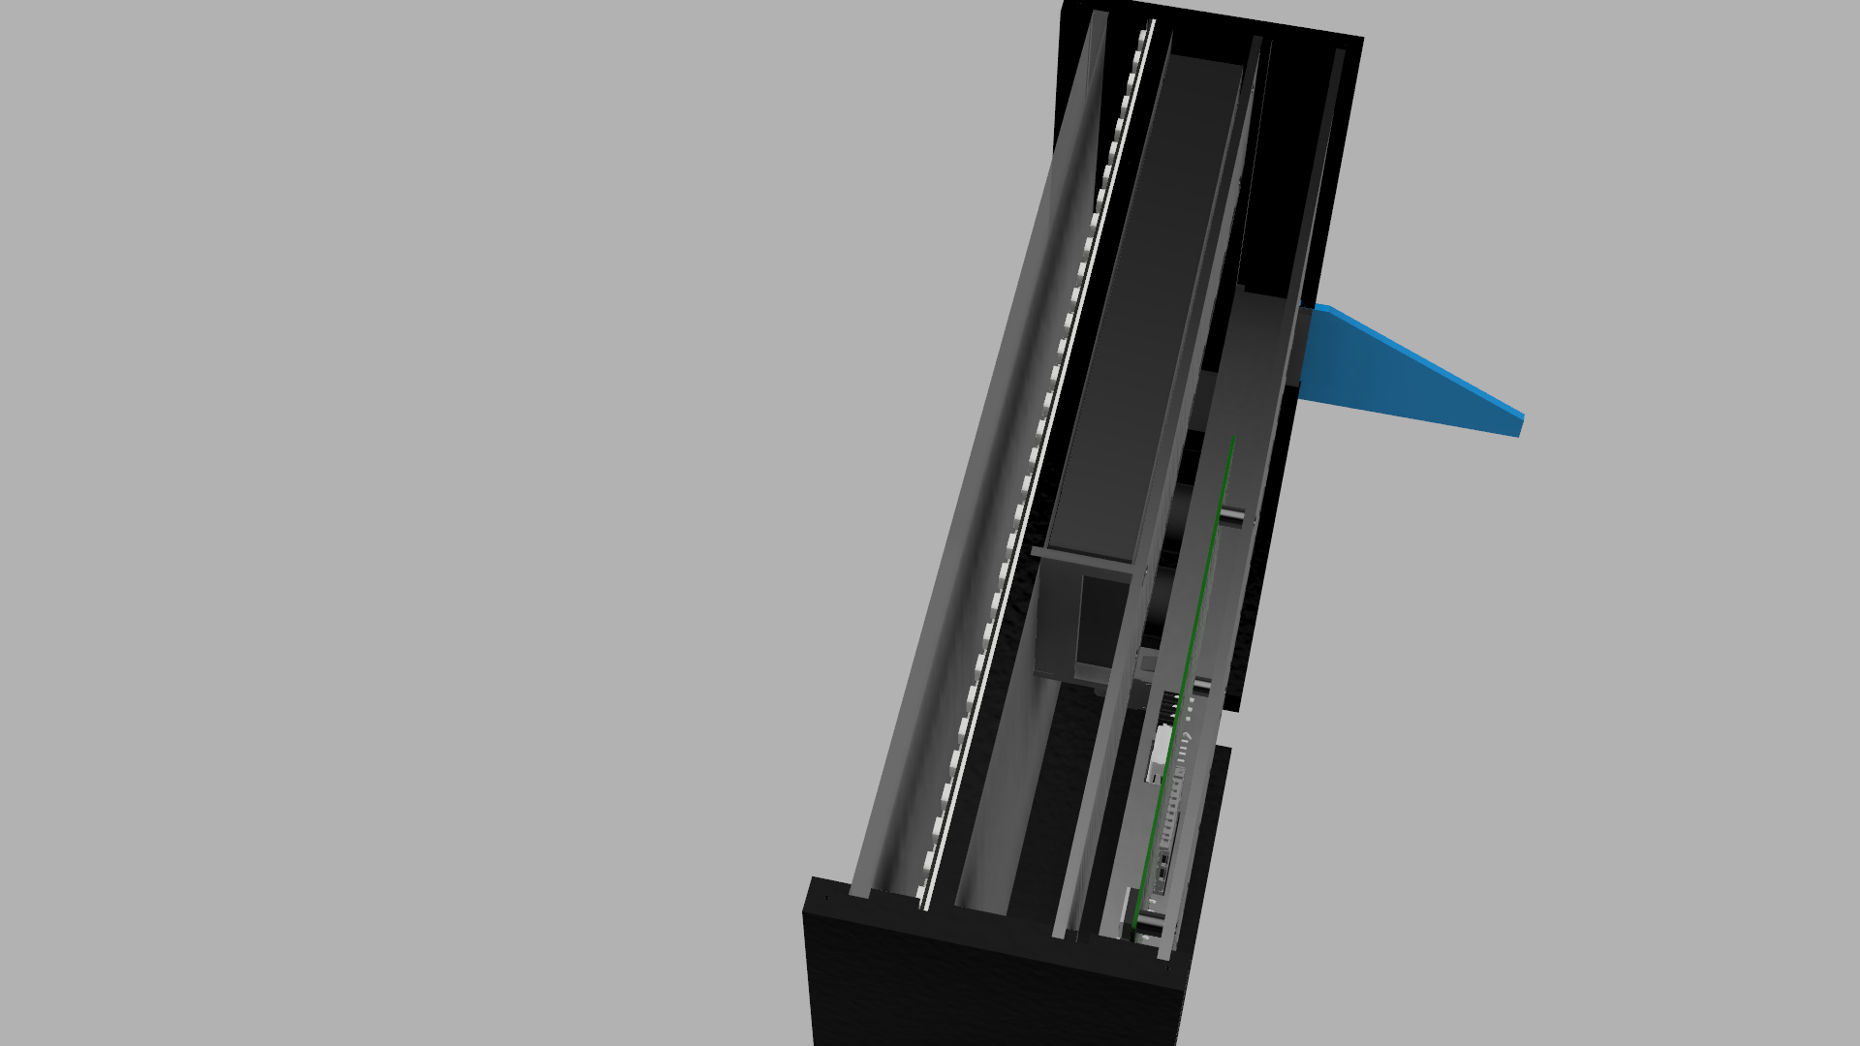
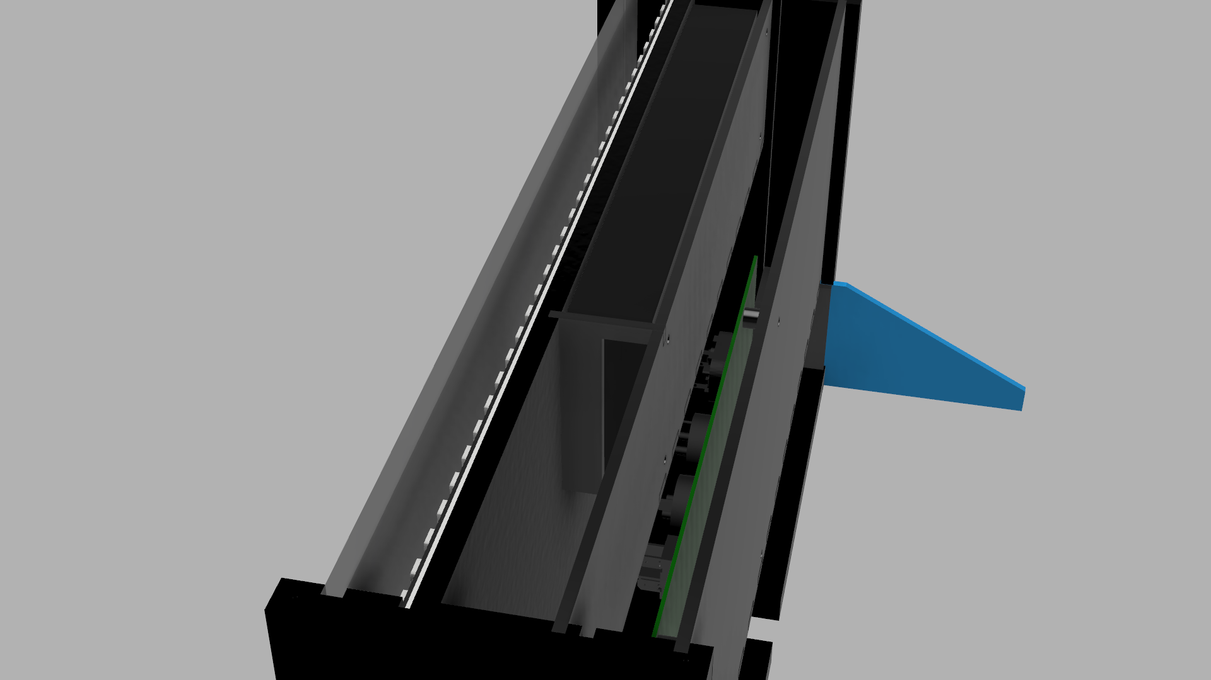
V44

Slide 78
V44
I extended the power supply mount to secure to both sides of the case as it would provide more support for the power supply and it adds more rigidity to the case
I added holes in the side of the case to allow the stands to be held in with bolts to prevent them from falling out

Slide 79
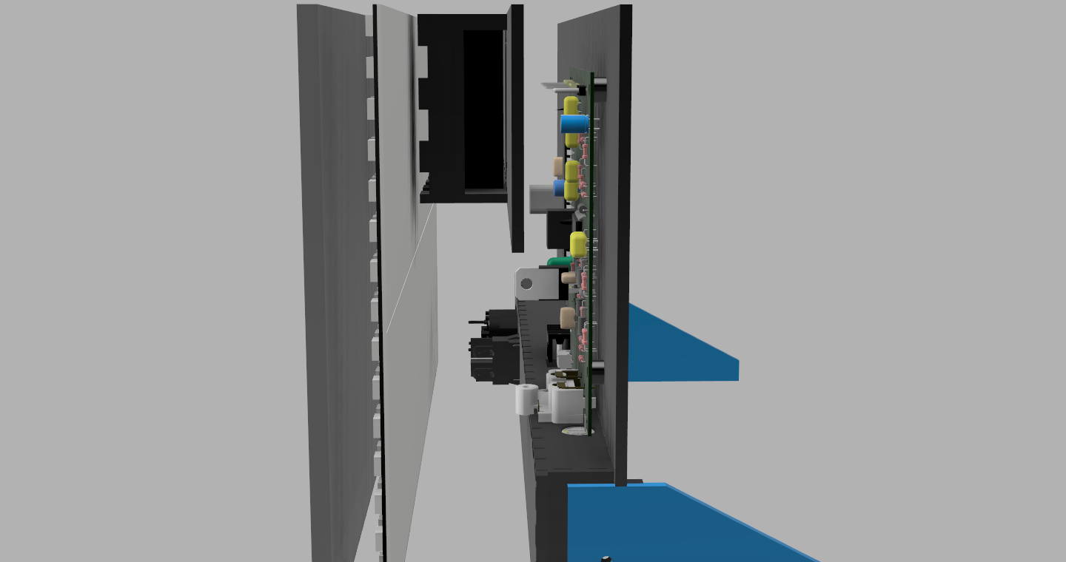



V47

Slide 80
V47
I decided to replace the 3.5mm audio sockets with 2 RCA connectors
I decided to not implement DMX into the product due to the limited functionality they would provide and the cost of the connectors, so I removed them from the product

Slide 81
Material Choices
I decided to use wood for most of the case because it is generally associated with high end products and it is very environmentally friendly and easy to recycle.
I used 3mm for the internal structures because of it being cheaper, easier to join and mount components to and it taking up less space.
I used 10mm for the case because it is stronger than 3mm plywood and it needed 3mm grooves cut into it for the other case pieces to mount into it.
I decided to use frosted black tinted acrylic for the screen protector because of its strength and optical properties, but I decided to use frosted to slightly diffuse the LEDs so the light will fill the gaps where there are no LEDs, and I decided for it to be tinted so the LEDs cannot damage people’s eyes, even at maximum brightness.
I decided to make the rear stands from 3mm black acrylic because it is stronger than plywood and the black colour makes them look professional and blend it with the rest of the case.
I made the PCB spacers from 3D printed black PLA plastic because I needed a precise spacing between the PCB and the rear panel and it is stronger than wood and it being more recyclable than ABS.
I used a mains power supply due to the large current requirements of the LED panels and it being better for the environment than using batteries which would be quickly used up.

Slide 82
Product Overview
Physical Design
Individual Casing Components
10mm MDF

Slide 83
Top and Bottom Pieces (2x)
All measurements in mm

Slide 84
Left Side Piece (1x)
All measurements in mm

Slide 85
Right Side Piece (1x)
All measurements in mm

Slide 86
Product Overview
Physical Design
Individual Casing Components
3mm WOOD

Slide 87
Rear Back Panel (1x)
All measurements in mm

Slide 88
Rear IO Panel (1x)
All measurements in mm

Slide 89
Rear PCB IO Panel (1x)
All measurements in mm

Slide 90
Rear Stand Covers (2x)
All measurements in mm

Slide 91
Back Power Supply Holder (1x)
All measurements in mm

Slide 92
Bottom Power Supply Holder (1x)
All measurements in mm

Slide 93
Side Power Supply Holder (1x)
All measurements in mm

Slide 94
LED Back Panel (Front) (1x)
All measurements in mm

Slide 95
LED Back Panel (Back) (1x)
All measurements in mm

Slide 96
Product Overview
Physical Design
Individual Casing Components
5mm Frosted Black Tinted Acrylic

Slide 97
Screen Protector (1x)
All measurements in mm

Slide 98
Product Overview
Physical Design
Individual Casing Components
3mm Black Acrylic

Slide 99
Rear Stands (2x)
All measurements in mm

Slide 100
Product Overview
Physical Design
Individual Casing Components
3D Printed Black ABS

Slide 101
PCB Standoffs (4x)
All measurements in mm

Slide 102
Product Overview
Physical Design
Individual Casing Components
Testing the designs for the case

Slide 103




Creating the main outside of the case

Slide 104


Prototyping the Rear Case Pieces

Slide 105
Plan
Prototyping

Slide 106
Controlling the LED panels
The led panels I bought have the LEDS arranged in a vertical snake
I created some code to convert an XY coordinate into the ID of the pixel
Diagram
┌ | ┐ | ┌ | ┐ | ┌ | ┐ | ┌ | ┐ | ┌ | ┐ | ┌ | ┐ | ┌ | ┐ | ┌ | ┐ | ┌ | ┐ | ┌ | ┐ | ┌ | ┐ | ┌ | ┐ | ┌ | ┐ | ┌ | ┐ | ┌ | ┐ | ┌ | ┐
│ | │ | │ | │ | │ | │ | │ | │ | │ | │ | │ | │ | │ | │ | │ | │ | │ | │ | │ | │ | │ | │ | │ | │ | │ | │ | │ | │ | │ | │ | │ | │
│ | │ | │ | │ | │ | │ | │ | │ | │ | │ | │ | │ | │ | │ | │ | │ | │ | │ | │ | │ | │ | │ | │ | │ | │ | │ | │ | │ | │ | │ | │ | │
│ | │ | │ | │ | │ | │ | │ | │ | │ | │ | │ | │ | │ | │ | │ | │ | │ | │ | │ | │ | │ | │ | │ | │ | │ | │ | │ | │ | │ | │ | │ | │
│ | │ | │ | │ | │ | │ | │ | │ | │ | │ | │ | │ | │ | │ | │ | │ | │ | │ | │ | │ | │ | │ | │ | │ | │ | │ | │ | │ | │ | │ | │ | │
│ | │ | │ | │ | │ | │ | │ | │ | │ | │ | │ | │ | │ | │ | │ | │ | │ | │ | │ | │ | │ | │ | │ | │ | │ | │ | │ | │ | │ | │ | │ | │
│ | │ | │ | │ | │ | │ | │ | │ | │ | │ | │ | │ | │ | │ | │ | │ | │ | │ | │ | │ | │ | │ | │ | │ | │ | │ | │ | │ | │ | │ | │ | │
┘ | └ | ┘ | └ | ┘ | └ | ┘ | └ | ┘ | └ | ┘ | └ | ┘ | └ | ┘ | └ | ┘ | └ | ┘ | └ | ┘ | └ | ┘ | └ | ┘ | └ | ┘ | └ | ┘ | └ | ┘ | └

Slide 107
Controlling the LED panels: Code
int PosToIndex(int POS_x, int POS_y){
int PIndex = 0;
bool isupperpanel = POS_y > 7;
if (POS_x % 2 == 0){
if (isupperpanel) {
PIndex = 23 - POS_y;
}
else {
PIndex = 7 - POS_y;
}
}
else {
PIndex = POS_y;
}
PIndex += 8*(31-POS_x);
if (isupperpanel) {
PIndex += 248;
}
return PIndex;
}

Slide 108

Basic Circuit
Programmer
Microcontroller
External Clock Crystal
Reset Button

Slide 109


Basic Circuit
The basic circuit was created from this schematic I found online specifying the basic components to get the microcontroller functional and available to be programmed with the Arduino IDE, my preferred method to program microcontrollers due to the large number of libraries available for it.

Slide 110



Initial Light Test
I determined that the LEDs were too bright just on their own so I added a piece of darkened acrylic and made a small program to test each LED sequentially

Slide 111

Initial Light Test

Slide 112

FHT Test
I joined the FHT example code to my basic LED test sketch with a bit of extra code to form bars from the FHT output of an audio signal

Slide 113

Using an SD card to change the default target image
I connect the SD card to the microcontroller using the recommended connections on the SDFat website

Slide 114

Using an SD card to change the default target image
I used a test image on the SD Card to check that it was reading the image correctly

Slide 115


Prototyping the amplification circuitry
I used an LM324 audio amplifier to test the circuitry for the audio input to adjust the components values to get a usable output signal ranging from 0V to 5V using the schematic I found in my research.

Slide 116

Prototyping the microphone amplification circuitry
I used an LM324 audio amplifier and an Electret microphone to determine the components values to produce a signal ranging from 0V to 5V using the schematic I found in my research.

Slide 117
Plan
Circuit Design

Slide 118

Circuit schematic

Slide 119
Circuit schematic
SD CARD CIRCUITRY
AUDIO AMPLIFICATION CIRCUITRY
MICROCONTROLLER CIRCUITRY
POWER CIRCUITRY

Slide 120
Schematic BOM
RefDes | Name | Value | Manufacturer |  | RefDes | Name | Value | Manufacturer
C1, C2 | CAP | 22pF |  |  | R4, R8, R9, R10 | RES | 2.2K
C3, C4, C10, C12 | CAP | 100nF |  |  | R5, R15, R16, R24 | RES | 100
C5, C6, C8, C9 | CAP | 10nF |  |  | R6, R17, R18 | RES | 2K
C7, C11 | CAP100RP | 10uF |  |  | R19 | RES | 10
D1, D2, D4, D5, D6, D7 | DIODE |  |  |  | R20, R21 | RES | 100K
D3 | LED-5R_Green | 5mm Round | Kingbright |  | R22 | RES | 20K
J1 | 1761782001 |  | Weidmüller |  | R23 | RES | 220K
J2 | 644456-3 | Panels | TE Connectivity |  | S1 | OS102011MS2QN1 |  | C&K
J3 | RCJ-2121 |  | CUI |  | S2 | B3F-1000 |  | OMRON
J4 | 644456-3 | IR | TE Connectivity |  | U1 | ATMEGA1284P-PU |  | Atmel
J5 | DM1AA-SF-PEJ_3D2 |  | Hirose |  | U2 | LM324N |  | Motorola
J6 | OSTOP020000 | Power | On Shore Technology |  | U3 | M74HC4050B1R |  | ST Microelectronics
J7 | 644456-6 | Prog. | TE Connectivity |  | U4 | LF33CV |  | ST Microelectronics
J8 | 644456-4 | I2C | TE Connectivity |  | U5 | B0505S |  | Mornsun
MK1 | AOM-6545P-R |  | Pui Audio |  | Y1 | ECS-110-S-1 | 16MHz
R1, R2, R3, R7, R11, R12, R13, R14, R25 | RES | 1K
RefDes | Name | Value | Manufacturer | Quantity
C1 | CAP | 22pF |  | 1
C2 | CAP | 22pF |  | 1
C3 | CAP | 0.1uF |  | 1
C4 | CAP | 0.1uF |  | 1
C5 | CAP | 10nF |  | 1
C6 | CAP | 10nF |  | 1
C7 | CAP100RP | 10uF |  | 1
C8 | CAP |  |  | 1
C9 | CAP | 10nF |  | 1
C10 | CAP | 100nF |  | 1
C11 | CAP100RP | 10uF |  | 1
C12 | CAP | 100nF |  | 1
D1 | DIODE |  |  | 1
D2 | DIODE |  |  | 1
D3 | LED-5R_Green | 5mm Round | Kingbright | 1
D4 | DIODE |  |  | 1
D5 | DIODE |  |  | 1
D6 | DIODE |  |  | 1
D7 | DIODE |  |  | 1
J1 | 1.76E+09 |  | Weidmüller | 1
J2 | 644456-3 | Panels | TE Connectivity | 1
J3 | RCJ-2121 |  | CUI | 1
J4 | 644456-3 | IR | TE Connectivity | 1
J5 | DM1AA-SF-PEJ_3D2 |  | Hirose | 1
J6 | OSTOP020000 | Power | On Shore Technology | 1
J7 | 644456-6 | Prog. | TE Connectivity | 1
J8 | 644456-4 | I2C | TE Connectivity | 1
MK1 | AOM-6545P-R |  | Pui Audio | 1
R1 | RES | 1K |  | 1
R2 | RES | 1K |  | 1
R3 | RES | 1K |  | 1
R4 | RES | 2.2K |  | 1
R5 | RES | 100 |  | 1
R6 | RES | 2K |  | 1
R7 | RES | 1K |  | 1
R8 | RES | 2.2k |  | 1
R9 | RES | 2.2K |  | 1
R10 | RES | 2.2K |  | 1
R11 | RES | 1K |  | 1
R12 | RES | 1K |  | 1
R13 | RES | 500 |  | 1
R14 | RES | 500 |  | 1
R15 | RES | 100 |  | 1
R16 | RES | 100 |  | 1
R17 | RES | 2K |  | 1
R18 | RES | 2K |  | 1
R19 | RES | 10 |  | 1
R20 | RES | 100k |  | 1
R21 | RES | 100k |  | 1
R22 | RES | 20k |  | 1
R23 | RES | 220k |  | 1
R24 | RES | 100 |  | 1
R25 | RES | 1k |  | 1
S1 | OS102011MS2QN1 |  | C&K | 1
S2 | B3F-1000 |  | OMRON | 1
U1 | ATMEGA1284P-PU |  | Atmel | 1
U2 | LM324N |  | Motorola | 1
U3 | M74HC4050B1R |  | ST Microelectronics | 1
U4 | LF33CV |  | ST Microelectronics | 1
U5 | B0505S |  | Mornsun | 1
Y1 | ECS-110-S-1 | 16MHz |  | 1

Slide 121


PCB Design
Top
Bottom

Slide 122


PCB Design
Top
Bottom

Slide 123
PCB Design
I designed my board to be double sided due to the sheer complexity of it because otherwise copious amounts of jumper wires would be needed
Due to my PCB being double sided, very complex and requiring small tolerances because of components such as the SD card socket, I was unable to use the PCB engraver to produce my PCB and had to result in getting the PCB etched to allow the fine detail required to produce my circuit
I added an I²C connector to allow for future expansion through the versatile expandability it allows and it bus style architecture

Slide 124




PCB Design – 3D Renders

Slide 125
PLAN
Software Design

Slide 126

Initial Program

Slide 127

Main Program

Slide 128

Processing Functions

Slide 129

Display Functions

Slide 130
Plan
Production Plan

Slide 131
Production Plan – part 1
Phase | Step | Time | Task | Equipment | Materials Used | Quality control | Safety Notes | Justification
1 | 1 | 01:00 | Cut out the 4 frame case pieces from the zip file Frame.zip, with a 4 flute 3mm centre-cutting end mill bit from a piece of 10mm A3 MDF using a CNC Router | CNC Router | 10mm A3 MDF | Visual Inspection to check it is correctly cut and sanding off any sprue left over | Wearing Safety Glasses and keeping hands out of the CNC machine when it is turned off, ensuring safety guard is in place before turning the machine on | I would use 10mm MDF because I am screwing into the end of it and if I used layered woods such as plywood, it would split along the layers, I would use a CNC Milling machine because I need to produce grooves for the case into it and they need to be accurate in order to fit the other case pieces into it
2 | 2 | 01:00 | Painting the 4 frame case pieces black with black wood stain | Paintbrush | Black wood stain | Visual Inspection to check all outside pieces of the frame are fully painted | Painting it in a well ventilated area and wearing gloves to prevent paint getting on their hands | I would paint the MDF case pieces with black stain to give them a discrete look / classy finish, this would also focus someones attention on the LED panels.
1 | 3 | 01:00 | Cutting out the rest of the pieces for the case from the zip file Case.zip with the rear stands being cut out of 3mm black acrylic, the screen cover being cut from 5mm black tinted frosted arcylic and the rest being cut from 3mm plywood | Laser Cutter | 3mm Plywood, 5mm Black tinted frosted acrylic, 3mm Black acrylic | Visual Inspection to check all case pieces are correctly cut and sanding to clean up edges on the plywood parts | Ensuring the laser cutter is shut before turning on the laser, having fire handling equipment available, not opening the laser cutter when it is on, monitoring the laser cutter to check nothing catches fire | I laser cut the rest of the case pieces, because it is a very quick way to cut out plywood, which is a cheap material that is also widely recyclable.
2 | 4 | 00:30 | Gluing panels together using wood glue and assembling the parts using a set square to ensure the parts are perpendicular from each other | Glue | Case parts | Visual inspection to check parts are successfully connected to each other and gently checking all joints are strong when the glue has dried | Wearing safety glasses, Washing hands after handling glue | I glued the internal case pieces because it would make the joints I made in the wood, even stronger helping the ridgidity of the case.
1 | 5 | 00:15 | Crimping the ends of the wires that connect to the power supply with 4.3mm Blue 1.1mm-2.6mm Eyelet Crimps and connecting | Crimping tool | 22 AWG wire, crimping ends | Visual check to ensure they are fully insulated, electrical test to check for continuity along the wire | Making sure the wires are not connected when they are being crimped, making sure their fingers are not in the crimping tool when they are using it | I crimped the internal power wires because it would prevent them from fraying, which could short or touch the case, this also makes them easy to connect and disconnect and insulates them from the case.

Slide 132
Production Plan – part 2
Phase | Step | Time | Task | Equipment | Materials Used | Quality control | Safety Notes | Justification
2 | 6 | 00:15 | Soldering the crimped LED panel wires to the LED panels power pads with the cables lying flat and then soldering the flat flex wires to the led panels to the relevant data pads | Soldering Iron | Crimped wires, 3 wire flat flex cable, solder | Visual check to make sure the solder joints look correct, temporarily attaching the LED panels to a test setup to ensure their correct functionality, gentle pulling the wires to check the joint is strong | Wearing Safety Glasses, making sure the led panels are not being touched when they are tested, | I soldered new wires to the LED panels because the wires they came with were too short and flimsy.
3 | 7 | 00:15 | Sticking the LED panels to the front LED backplane, with the LED panel that is to be connected to the control board at the bottom with wide double sided tape and masking tape holding down the wires so they are flat |  | Wide double sided tape, masking tape | Visual check to make sure the LED panels are straight and in the right position and checking the tape is holding the wires flat. Testing the LED panels again to check they are functional | Watching out for the sharp edges on the LED panels | I stuck the LED panels to the backplane because the LED panels came on flexible PCBs and so stuck them to the backplane to keep them flat.
3 | 8 | 00:05 | Attaching the power supply to the power supply holder with M3 nuts and bolts | Pliers and Screwdriver | M3 Nuts and Bolts | Visual check to make sure they are all in correctly and gentle test to check it is secured properly | Making sure the power supply is not connected when attaching it | I attached the power supply with M3 nuts and bolts to allow the power supply to be removed if required.
4 | 9 | 00:10 | Attaching the relevant wires to the power supply with the mains wires connected to the mains terminal and the low-voltage wires connected to the low-voltage terminals | Screwdriver |  | Visual check to make sure they are attached in correctly and gentle test to check they are secured properly | Making sure the mains wires are not plugged in when attaching them and checking that the terminals are not being shorted | I attached the crimped wires to the power supply before I assembled the rest of the case before it was too hard to do it.
1 | 10 | 00:45 | Assembling the circuit board with the relevant components on the BOM starting with the SD card slot then, resistors, diodes, crystal, switch, button, ceramic capacitors, IC sockets, LEDs, headers, terminal sockets, voltage regulators, RCA connectors and finally, inserting the ICs | Soldering iron | PCB, solder, relevant components from BOM, cutters, | Visual check to ensure joints are correct, all leads are cut, continuity test to check all joints are conductive and electrical test to check the control board is functioning correctly | Wearing safety goggles, ensuring not touching the tip of soldering iron, angle the board away from eyes when cutting leads, allowing joint to cool before touching | I assembled the PCB starting with the SD card socket and then put in the rest of the components in size order to make sure they go in straight.

Slide 133
Production Plan – part 3
Phase | Step | Time | Task | Equipment | Materials Used | Quality control | Safety Notes | Justification
1 | 11 | 00:15 | Printing four PCB spacers on a 3D printer with the file "PCB Spacer.stl" with any colour PLA, with layer height on smallest and with the largest infill percentage. | 3D printer, chisel | Any colour PLA filament | Physical check to ensure printed correctly, measurement with callipers to check it is the correct height, testing an M3 bolt to check it fits correctly | Wearing gloves, waiting for print bed to cool down before removing print, using the chisel away from yourself to prevent stabbing yourself | I 3D printed the spacers for the PCB due to the precise spacing to allow the ports to line up with the connectors, I used the most detail and solid infill to get the strongest ones.
3 | 12 | 00:10 | Attaching the PCB to the back panel with the 3D printed spacers and M3 nuts and bolts | Pliers and Screwdriver | M3 Nuts and Bolts | Visual check to ensure the PCB is attached correctly, and gentle pull to check the PCB is secured correctly | Ensuring you don’t accidentally stab yourself with the screwdriver or pliers | I attached the PCB with M3 nuts and bolts to allow the PCB to be easily removed if required.
5 | 13 | 00:15 | Assembling all of the case pieces together in the main frame and bending the IR receiver to fit in the case and inserting the power supply cables into the power switch and IEC socket and attaching the cables to the PCB | Pliers and Screwdriver | Electrical tape, wood screws | Visual check to ensure all case pieces are aligned correctly, the connectors are in the correct sockets and electrical test to check the case is insulated from the mains power | Making sure the mains power is disconnected before assembling, and taking care when inserting the screws | I made the IR receiver fit next to the LED panels to make it be discrete and not noticible so it doesn’t affect the looks of the case.
6 | 14 | 00:10 | Closing the case and polishing the screen protector | Screwdriver | Wood screws, Polish, Cloth, wood screws | Visual check to check if the screen protector is clean from smudges and checking the case is securely closed | Wearing goggles to ensure polishing agent does not get into eyes, washing hands after polishing to remove polish from hands | I polished the screen protector to remove any marks from production on it to give it better optical clarity.
7 | 15 | 00:25 | Testing to check that the IR remote is functional, the LED panels are working correctly, the SD card interface is working correctly, the audio input are functioning correctly, the case is isolated to ground and the case looks good | Multimeter, PAT tester | IR Remote | Visual check to see if the case is in good quality, the screen protector is not scratched, the LED panels are working, an electrical test to check the power supply is not broken and it passes a PAT test | Keeping hands away from the product when it is being tested, ensuring the power cables is disconnected before probing the device | I gave it a rigorous testing to ensure that it was working correctly, and performed all of its functions successfully.
Total: 6:30

Slide 134
Production Process
00:00 | 00:05 | 00:10 | 00:15 | 00:20 | 00:25 | 00:30 | 00:35 | 00:40 | 00:45 | 00:50 | 00:55 | 01:00 | 01:05 | 01:10 | 01:15 | 01:20 | 01:25 | 01:30 | 01:35 | 01:40 | 01:45 | 01:50 | 01:55 | 02:00 | 02:05 | 02:10 | 02:15 | 02:20 | 02:25 | 02:30 | 02:35 | 02:40 | 02:45
1 |  |  |  |  |  |  |  |  |  |  |  | 2 |  |  |  |  |  |  |  |  |  |  |  | 13 |  |  | 14 |  | 15
3 |  |  |  |  |  |  |  |  |  |  |  | 4 |  |  |  |  |  | 7 |  |  | 8 | 9
5 |  |  | 6 |  |  | 10 |  |  |  |  |  | 11 |  |  |  |  |  | 12

Slide 135
Construction
Physical Casing

Slide 136





Physical Casing

Slide 137
Physical Casing
Due to having no access to a CNC Milling machine, I was forced to manufacture the Side panels with a laser cutter.
Ideally, it would be milled from 10mm MDF which would lead to it being stronger as I am having issues with the layers separating due to it being laser cut from plywood.

Slide 138
Construction
PCB

Slide 139



PCB

Slide 140
PCB
The PCB was very easy to assemble and went together without any problems.
The microphone was attached to the board with flimsy legs, if it is pushed into the case it could break off the board, ideally a custom mount would be required to give it more stability.

Slide 141
CONSTRUCTION
Final

Slide 142







Final

Slide 143
Final
I discovered that when the screen data is being sent to the display, the microcontroller is unable to receive IR signals, causing IR signals to not be received.
Using the I²C connector on the PCB I added for future expansion, I used an ATTINY85 microcontroller to receive the IR signals and send them to the main microcontroller when it requests for them, solving the problem.

Slide 144
Construction
Testing

Slide 145
Testing
To test to product I ran a 1KHz sine wave through the audio inputs and then through the microphone to observe that only the specific frequency bands were being displayed. I also ran a test program to cycle each colour through on each LED to check that they were all working correctly
I also used a multimeter to check that the case was not connected to the mains power to ensure that it is not dangerous and it was earthed
I also checked using an oscilloscope to check that the correct signals and voltage levels were reaching the microcontroller on all of the inputs
I gave it a visual inspection to check the casing looked good and all the paint was evenly coated and that there were no scratches on the screen
I also checked that the IR remote was being correctly received from 3m away from the case with the remote being directly pointed at it and that the correct remote codes were being received
I used a test pattern to check that the LED panels were correctly oriented and that they were interpreting images correctly with all of the correct colours and positioning

Slide 146
Conclusion
Software Evaluation

Slide 147
Software evaluation
Overall I think the software was a success but some changes could have been made such as more optimisations such as implementing more code into separate functions to reduce code repetition.
More configuration options through the remote could have been implemented to enable configuring system settings to allow the user to change the way the signal is displayed.
Saving the current settings to the EEPROM was a nice feature as it stopped you from having to change the pattern and audio source whenever it was turned on.

Slide 148
Conclusion
Product Evaluation

Slide 149
Evaluation
It will have an internal power supply as it will need to produce 30A for the LED panels at 5v.
It will use a standard IEC power connector with a hard power switch.
It used the 30A at 5v as per planned with and IEC connecter and a 5A mains switch isolating power from the power supply, for a future version, the LEDs could dynamically change their brightness to maintain a lower current to save power.
It will have a black painted wood case to make the display stand out
The wood will be painted black once the unit is assembled to hide the joints in the wood
I used a black painted case made from wood as per planned, although, a laser cutter was used to create the parts, if I made a future version I would use as CNC Milling machine to mill the parts from MDF, this would have created a stronger case as the side panels were made from layers of plywood, which are not as strong as MDF.
There will be a clear acrylic sheet in the front of the case to protect the led boards and to stop people touching the led boards
I used a piece of 5mm frosted black tinted acrylic because the LEDs were brighter than planned and they needed to be diffused because it filled in the dark spots between LEDs, for a future version the LEDs could dynamically change their brightness to prevent it needing a piece of tinted acrylic and just a piece of frosted acrylic to allow the LEDs to be slightly diffused.
Picture hook for the option to wall mount the unit
I did not add a picture hook for the product as the case would need to be redesigned for it to work as the piece I had planned to mount it onto was not strong enough to hold it, for a future version, the case could be redesigned to incorporate the picture hook.

Slide 150
Evaluation
It will have mounting slots on the back for laser cut acrylic legs to make the unit more stable so it doesn’t fall over. The acrylic legs will have holes in them for a screw in the side of the case to slot into them so they are secure and they don’t fall out
I added them from a piece of black acrylic and they worked as planned as the unit was quite top heavy owing to the power supply being mounted near the top of the case, they successfully prevent it from also being knocked over, for a later version a better way to secure them would help as inserting the screws can be tedious.
It will have the power socket, audio ports and SD card slot recessed on back of unit in a recess that so when it is on a wall it lies flat. The recess will have the inputs at a 90° angle so the ports are facing sideways. The recess will be fairly large to allow for different connector sizes and cables
I added the power socket in the form of an IEC socket, the audio ports in the form of RCA sockets, and a full size SD socket was installed to allow Image Data to be loaded, for a later version 3.5mm audio sockets could be added to allow different connector types.
It will have a groove cut out of bottom lip on unit so cables can run down the wall it is mounted on
I added the groove in the bottom to allow cables to run down a wall but due to not being able to add a picture hook, it is not currently being used, for a future version it could have a loop for using a cable tie to keep the cables tidy, it could also be made bigger to allow larger cables to fit through it. Visually it could be centred as currently it is not centred and this does not look right.
It will have a hard power switch on side of unit so power can be completely isolated from the unit to minimise fire risk
I added a hard power switch which successfully isolates the mains power to the power supply but it is mounted on the back of the unit which allows the unit to be placed up flat against walls and it looks neat as otherwise it would have interfered with the rear stands, for a future version, it could have an led in it to allow the user to see if it is switched on so they can easily know if it is turned off, which reduces fire risk.

Slide 151
Evaluation
The audio inputs it will have:
Microphone for use with audio sources which can be heard by the unit and do not want to use an Aux cable
Microphone should be mounted to the front of the unit for the best signal from the sound in the surrounding area
Microphone needs a preamp to bring it up to line level
3.5mm audio socket with another 3.5mm audio socket for pass-through and isolation so it doesn’t distort the audio going in if they are using a passive splitter
Audio must be actively converted to mono to prevent distortion on the audio input as it could be passively split somewhere or be using the pass-through socket
I used an Electret microphone with an amplifier to bring it up to a signal that the microcontroller can read, for a future version, I could mount the microphone near the front, next to the IR receiver to allow it to better pick up sound. I used RCA sockets without a pass-through to prevent distortion when it is being passed through and the connecters are stronger than 3.5mm and are harder to accidentally pull out, for a future version both could be used to allow the user to choose which connecter they want and audio isolator could be used to allow the signal to be passed through it.
All audio inputs must be isolated from each other and when an input is selected it must pass through an auto volume control circuit before entering the microcontroller. So the audio can be scaled to get the most amount of detail out of it
The audio inputs are not isolated but do not affect each other, the signal does not pass through an auto volume control circuit but passes through an amplifier to allow the best use of the signal, for a future version, an auto volume circuit could be implemented to allow quieter audio signals to be used and the audio signals could be isolated to prevent distortion.

Slide 152
Evaluation
It will have an IR remote control for control without touching the unit
A button on the remote should be used to change between the audio inputs and turn of the unit in turn in the pattern: Aux socket, Microphone, Off
A button on the remote should be used to change the display style for the spectrum analyser, modes could include variants of live mode showing the current audio frequencies, peak hold mode where dots show when the audio peak in the last few seconds and how high the peak was, and a mode when the whole screen is on and gets dimmer and gets brighter when a beat happens in the audio. The modes could include horizontal or vertical variants of these modes.
A button on the remote should be used to change the colour pattern of the screen. Patterns would be stored on a SD card with a picture for each pattern so the user could create their own patterns
I added an IR remote but required a secondary microcontroller to be added due to the main microcontroller not being able to read the IR receiver when it is sending data to the display, some of the display styles were not implemented but could be implemented in a later version of the firmware, for future versions the secondary microcontroller could be added to the main control board instead of an external interface board and it could also use the number buttons on the remote the quickly change the pattern to a specific ID.
The unit must have an SD card slot for image files stored on an SD card. The file format used will be a custom file type for storing images for the led matrix
Images will be stored in a folder called .imx
I created a program on windows using python to convert images into a simple image format that can easily be used by the microcontroller, the program stores the data on a database on the SD Card and it stores the files in a folder called “.imxs” with the image files being called “.imx” and the file containing the number of patterns called “imdbsize.dbl”, for a future version, native support for image types such as “.jpg” and “.png” could be used instead of the custom program on windows.

Slide 153
Other points for evaluation
If I was designing the case again I would make the space for cables larger so it is easier to insert cables. I would also get the frame of the case milled from 10mm MDF using a CNC Milling machine as I originally planned but wasn’t able to due to not having access to one.
If I was designing the PCB again I would incorporate the external IR receiver board I added to solve the problem that I had when trying to receive the infrared signals.
If I was producing the product again I would embed the IR receiver into the edge of the case because where it is now, behind the screen protector, it limits the range of the IR remote. I would also get a custom remote made like the remote I have now, but with custom labels.
If I was making the product again I would use locking JST connectors because there is a chance the internal wiring could fall out of the 2.54mm headers I used.

Slide 154
Conclusion
Photos

Slide 155






Photos

Slide 156







Photos

Slide 157
Conclusion
Mass Production

Slide 158
Mass production
Improvement | Reason
Surface mount components | The components on the PCB could be changed to be surface mount allowing the PCB to be more compact and easier to assemble by a pick and place machine.
Injection moulded case | The case could be injection moulded which would be cheaper, easier to mass produce, and eliminate the need for it to be painted.
1 Large LED panel | The 2 flexible LED panels and the back-plate they are attached to with double sided tape could be replaced with a large ridged PCB which would also replace the back-plate that prevents the LED panels from flexing.
Mounting IR Receiver on the front of the case | The IR receiver could mount directly into a hole in the casing so it is not behind the screen protector which is limiting the range of the IR receiver. It could be mounted to a hole in the edge casing material with an LED to allow the user to know if it can see their IR signal.
Have the IO Panel labels directly engraved onto the case | The labels for the IO panel could be directly engraved onto the IO panel itself, removing the need for a label to be stuck onto the IO panel, simplifying the production process.
Moulding the switch and IEC socket into the case | The power switch and the IEC socket could be directly moulded into the case removing the need for them to be screwed in and giving them more strength.

Slide 159
Conclusion
Feedback and Possible Improvements

Slide 160
Look
“It looks bright, flashy, cool, but the back of the case would look better if it was painted and the case would look better in black plastic.” – R. Fairweather
I agree with Rhiannon as the back of the case would look better if it was painted and the case would look nicer if it was made from black plastic as it would give it a cleaner, more modern look.

Slide 161
Usage
“I liked the flexibility of the different patterns, the brightness control, and the vibrancy of the colours, but the area for cables was too small as it was blocked by the case, it also need the remote control to have better labels on it” – A. Bouwer
I agree with Adam as I also found that the area for cables was too small and made it hard to insert cables, this could be solved by removing the case below the IO or by using right angle cables.
It also needs to have a labelled remote which would be easy to mass produce and would make the product much more easier to use.

Slide 162
Design
“I like the size of it as it would work in a house party or small venue, but a bigger version would be better for larger venues.” – A. Tiwari
I agree with Ayush as it is a nice size for somewhere small, but a larger, more detailed version for larger venues would be nice to make with support for different mounting systems for use in clubs.

Slide 163
Design
“It would look cool if there was water that jumped with the display.” – H. Kandelwal
I disagree with Hithik as the water could be an inconvenience as it could make the product heavier and if it was damaged it could leak water, also the noise the water would make would interfere with the microphone and would distort the signal.

Slide 164
Conclusion
Summary

Slide 165
Summary
Overall think my product was very successful and is very entertaining to look at due to its bold, vibrant colours. I think it would have look better if the outside case pieces were manufactured by a CNC Milling machine.
I think that although I faced some challenges such as the IR receiver requiring a separate microcontroller, the project was a success and after a few optimisations, it would be ready for mass production.
I think if I was to make it again I would look into different materials to make the case out of which could be stronger and more durable as the case is quite fragile, due to it being made from wood.
If I designed it again I would look at cheaper and lower energy LED panels as they were expensive and also required and expensive power supply. I would also look at different LED types such as four wire LEDs such as LPD8806 which require a clock pin along with a data pin which allows the microcontroller to perform interrupts while sending out LED data.

Slide 166


https://youtu.be/etPx_hBegjY

